Slide 1
The application of CALPHAD based tools to the Materials Genome Initiative and ICME
Paul Mason
Thermo-Calc Software Inc.
4160 Washington Road, Suite 230
McMurray, PA 15317

Slide 2
The 2008 National Academies report on Integrated Computational Materials Engineering (ICME) and President Obama's announcement of the Materials Genome Initiative (MGI) in June 2011 highlights the growing interest in using computational methods to aid materials design and process improvement.
For more than 30 years CALPHAD (CALculation of PHAse Diagrams) based tools have been used to accelerate alloy design and improve processes. CALPHAD is based on relating the underlying thermodynamics of a system to predict the phases that can form and the amounts and compositions of those phases in multicomponent systems of industrial relevance.
During this lecture, you will:
- Discover how CALPHAD relates to ICME and MGI
- Learn about the underlying concepts of the CALPHAD approach
- See how CALPHAD-based computational tools may be applied in the materials life cycle for a range of different materials.
Goals of this lecture

Slide 3
There are three main sections to this lecture:
1. Describing what ICME, MGI and CALPHAD are and how CALPHAD fits into the larger ICME and MGI framework
2. A more detailed description of CALPHAD, CALPHAD based software tools and databases that underpin them.
3. Some practical examples of applications to the materials life cycle.
Outline

Slide 4
The National Academies Press, 2008
Integrated Computational Materials Engineering: A Transformational Discipline for Improved Competitiveness and National Security
What is ICME?
ICME: an approach to design products, the materials that comprise them, and their associated materials processing methods by linking materials models at multiple length scales. Key words are "Integrated", involving integrating models at multiple length scales, and "Engineering", signifying industrial utility.
Focus is on the materials, i.e. understanding how processes produce material structures, how those structures give rise to material properties, and how to select materials for a given application. This report describes the need for using multiscale materials modeling to capture the process-structures-properties-performance of a material.

Slide 5
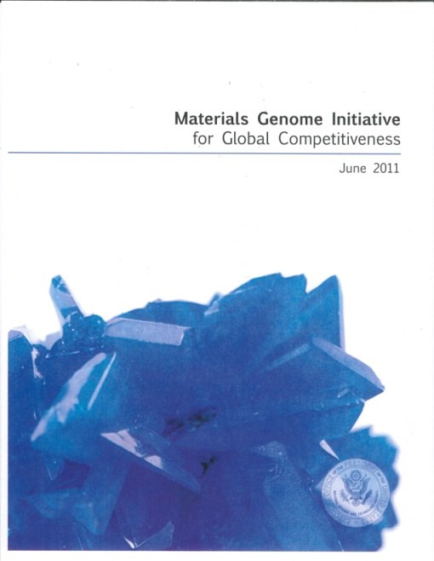
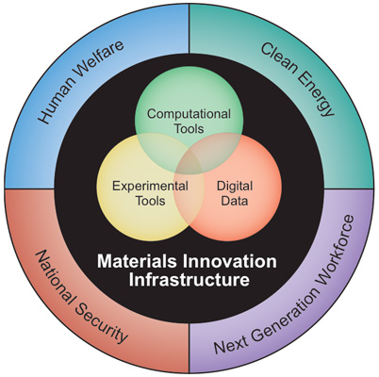
What is MGI?
June 2011
Materials Genome Initiative for global competitiveness
The Materials Genome Initiative is a national initiative to double the speed and reduce the cost of discovering, developing, and deploying new advanced materials.

Slide 6
The influence of chemistry on microstructure and properties
Chemical Composition
Properties
Microstructure
Processing
Heat treating can best be defined as “the controlled application of time, temperature and atmosphere to produce a predictable change in the internal structure (i.e. the microstructure) of a material.” Dan Herring, 100th Column of the “Heat Treat Doctor” published in Industrial Heating magazine

Slide 7
The analogy of a materials genome to a human genome implies that something of the nature of the material is encoded in the the chemical composition of a material and that we should be able to read this.
But nurture is important, as well as nature, and to extend the analogy further, nurture is the equivalent of processing the material.
In ICME/MGI we are striving to model how the structure and properties of a material are affected by its composition, synthesis, processing and usage.
Modelling of structure evolution and kinetic processes thus depends on what models are available for structure-property relations.
What should be modeled in the ICME and MGI?

Slide 8
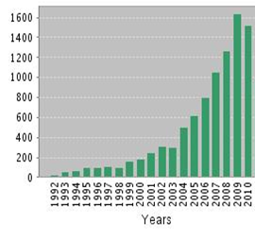
A phase based approach to modeling the underlying thermodynamics and phase equilibria of a system through a self consistent framework that allows extrapolation to multicomponent systems.
A journal published by Elsevier Ltd.
An international community, and conference held each year with 150-300 active participants from around the world.
What is CALPHAD?
CALculation of PHAse Diagrams

Slide 9
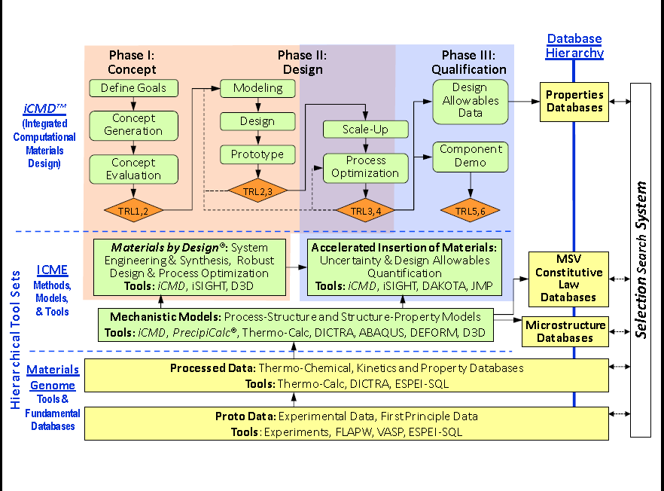
CALPHAD – a foundation of MGI, ICME and ICMD
Slide courtesy of Prof. G. Olson, Northwestern University, QuesTek Innovations LLC

Slide 10
Requirements for modeling microstructure evolution
The phases that form and their composition under given conditions (over-all composition, temperature and pressure) (Thermo-Calc )
How do these quantities evolve in time? (DICTRA, TC-PRISMA, phase field)
–Synthesis and processing
–Usage
Length scale of microstructure (Phase-field)
Stresses
Details of morphology
Statistics – size distributions etc (TC-PRISMA)
Slide courtesy of Prof. J. Ågren, KTH

Slide 11

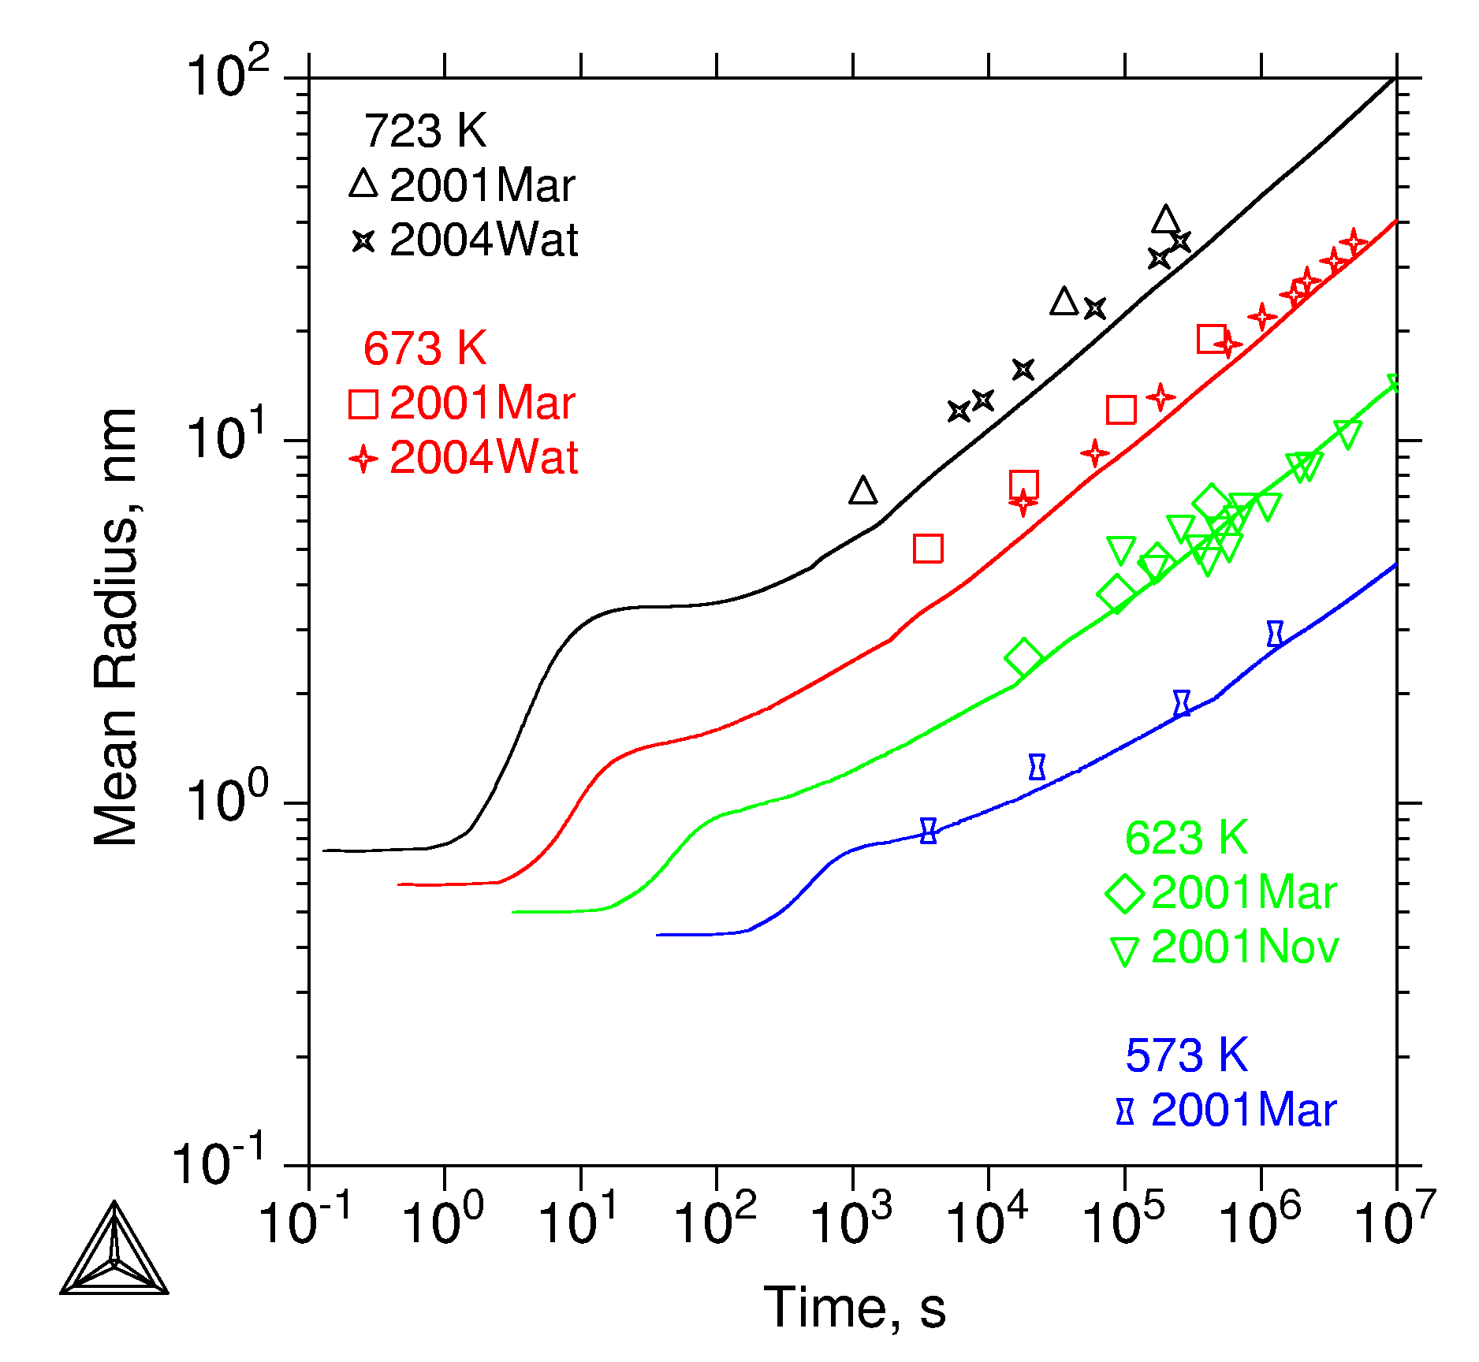
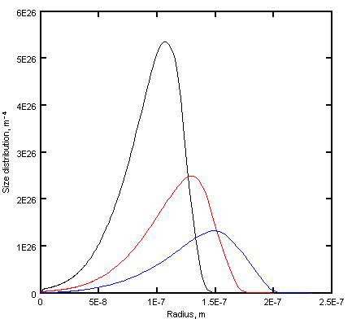
The development of consistent databases where each phase is described separately using models based on physical principles and parameters assessed from experimental data is a key.
CALPHAD – an important bridge to multicomponent prediction
Towards prediction of microstructure evolution and material properties
Bridging Atoms and Microstructure
TC-PRISMA

Slide 12
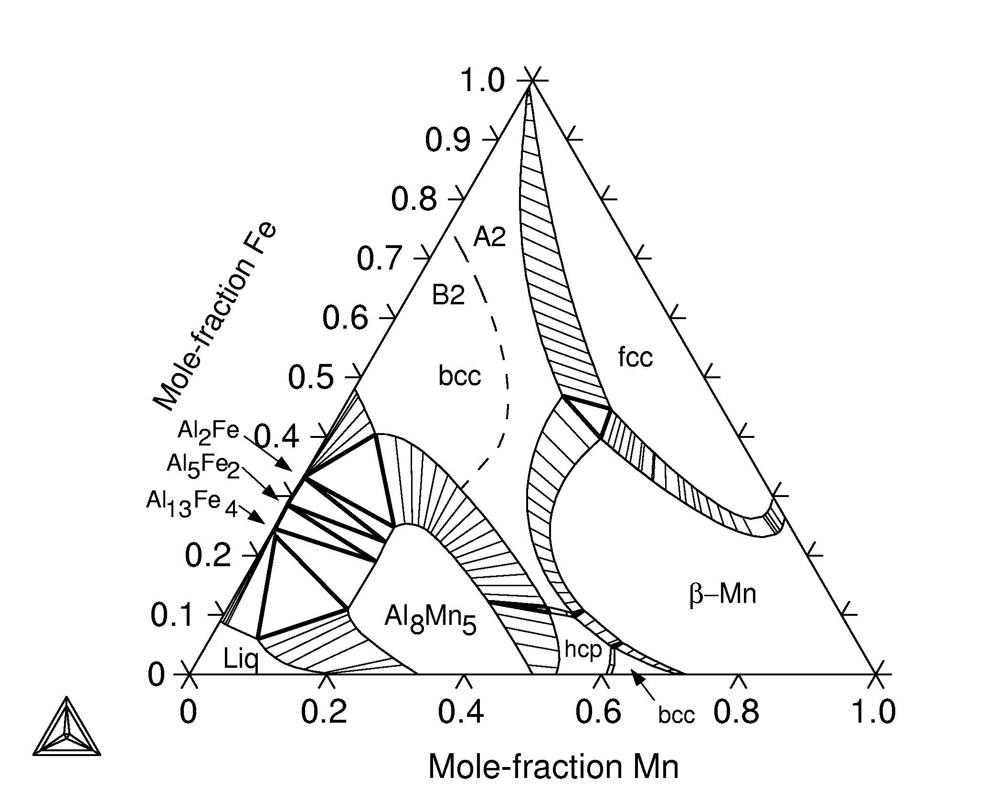
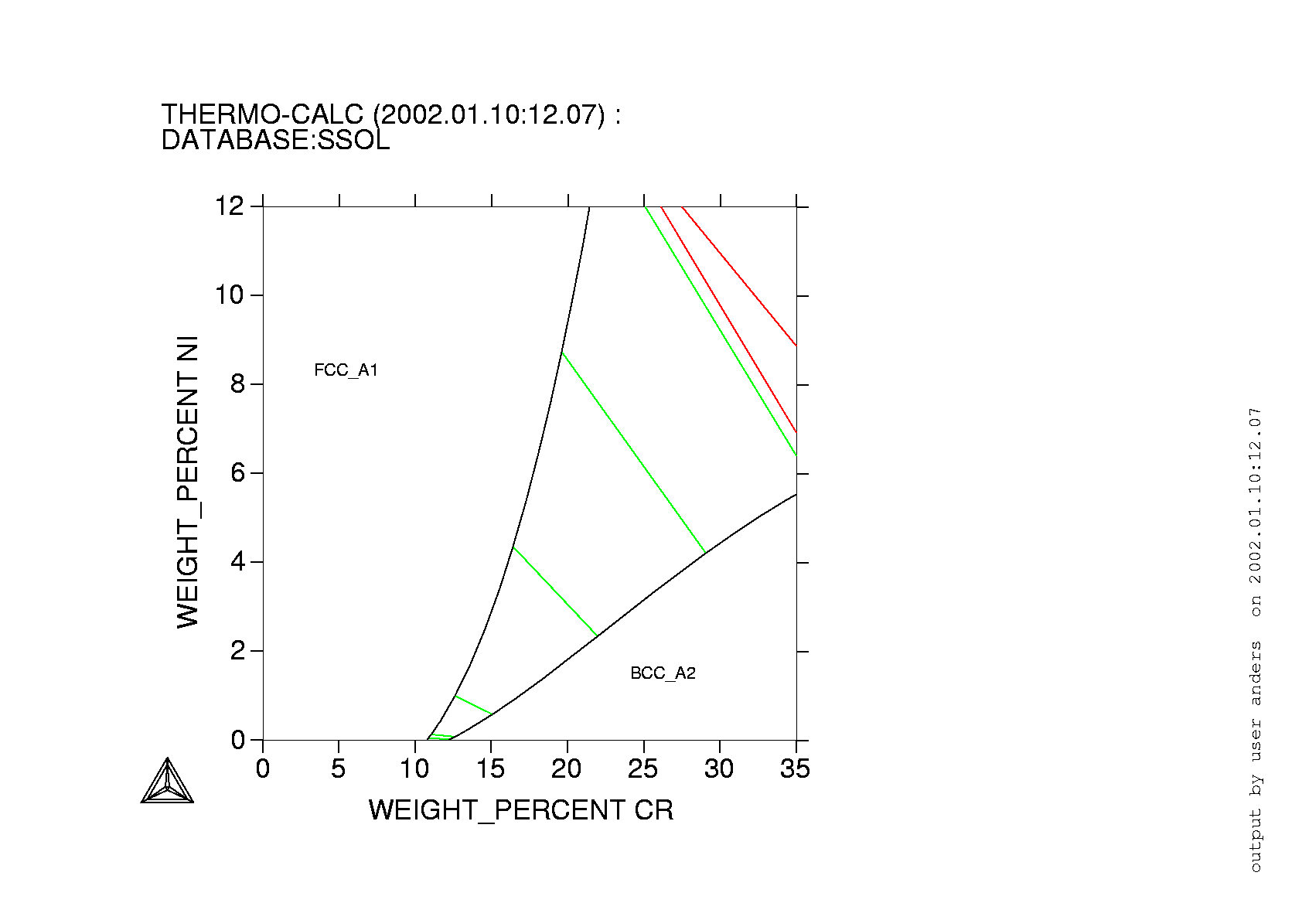
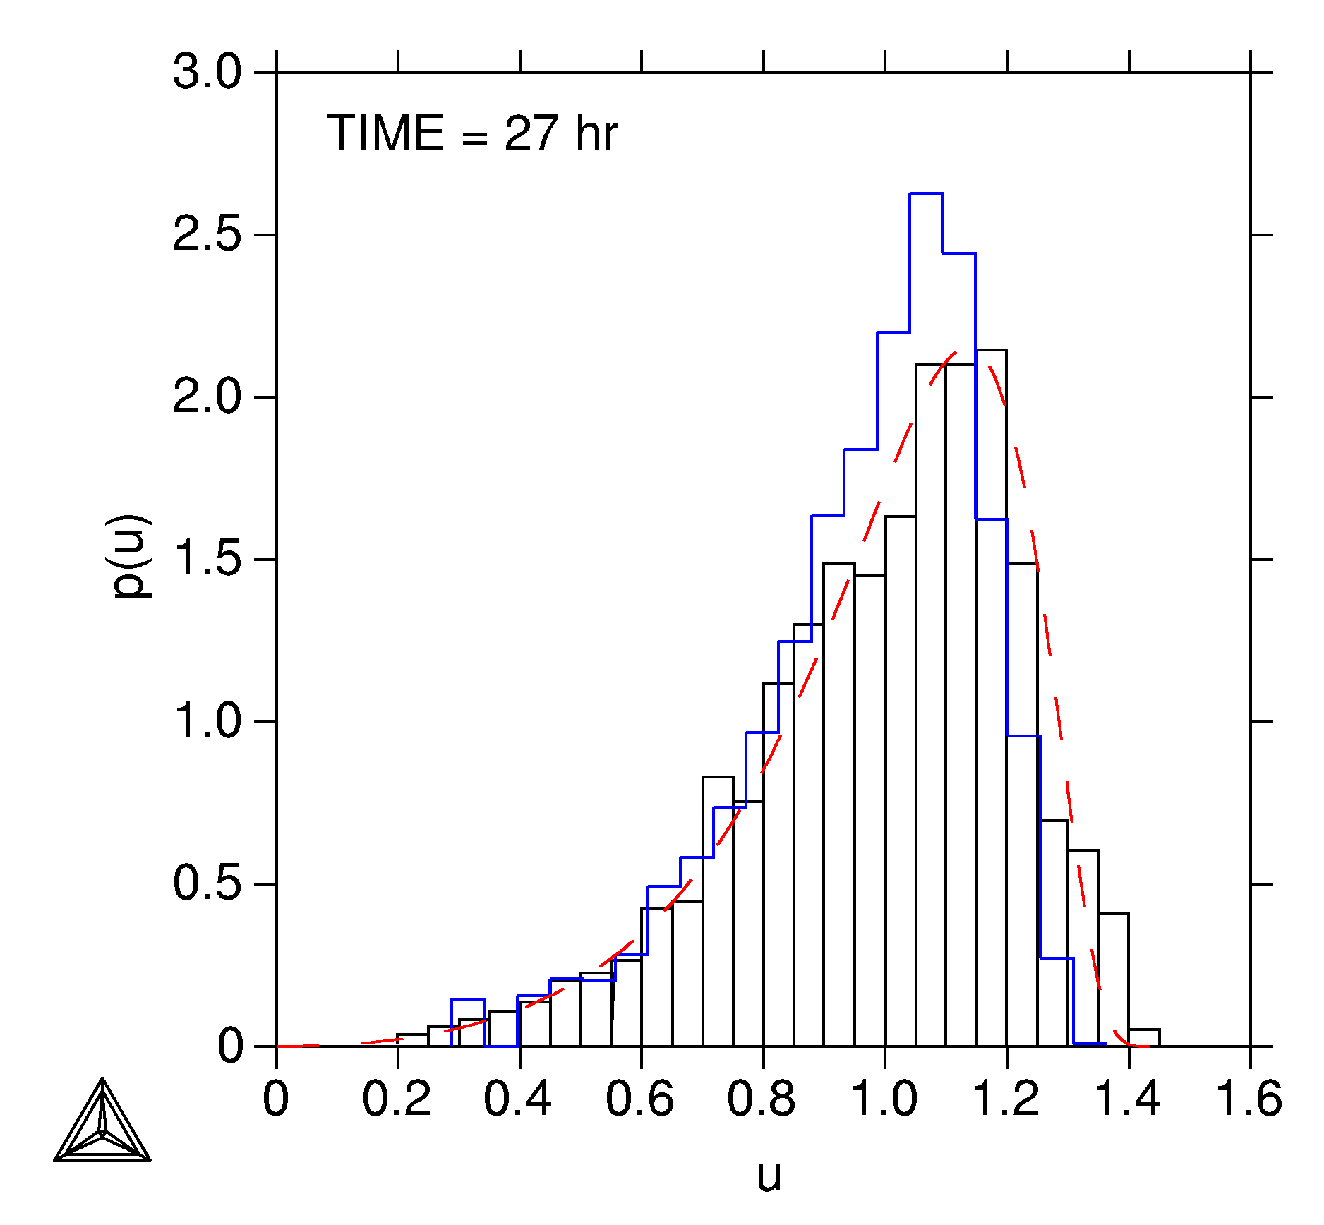
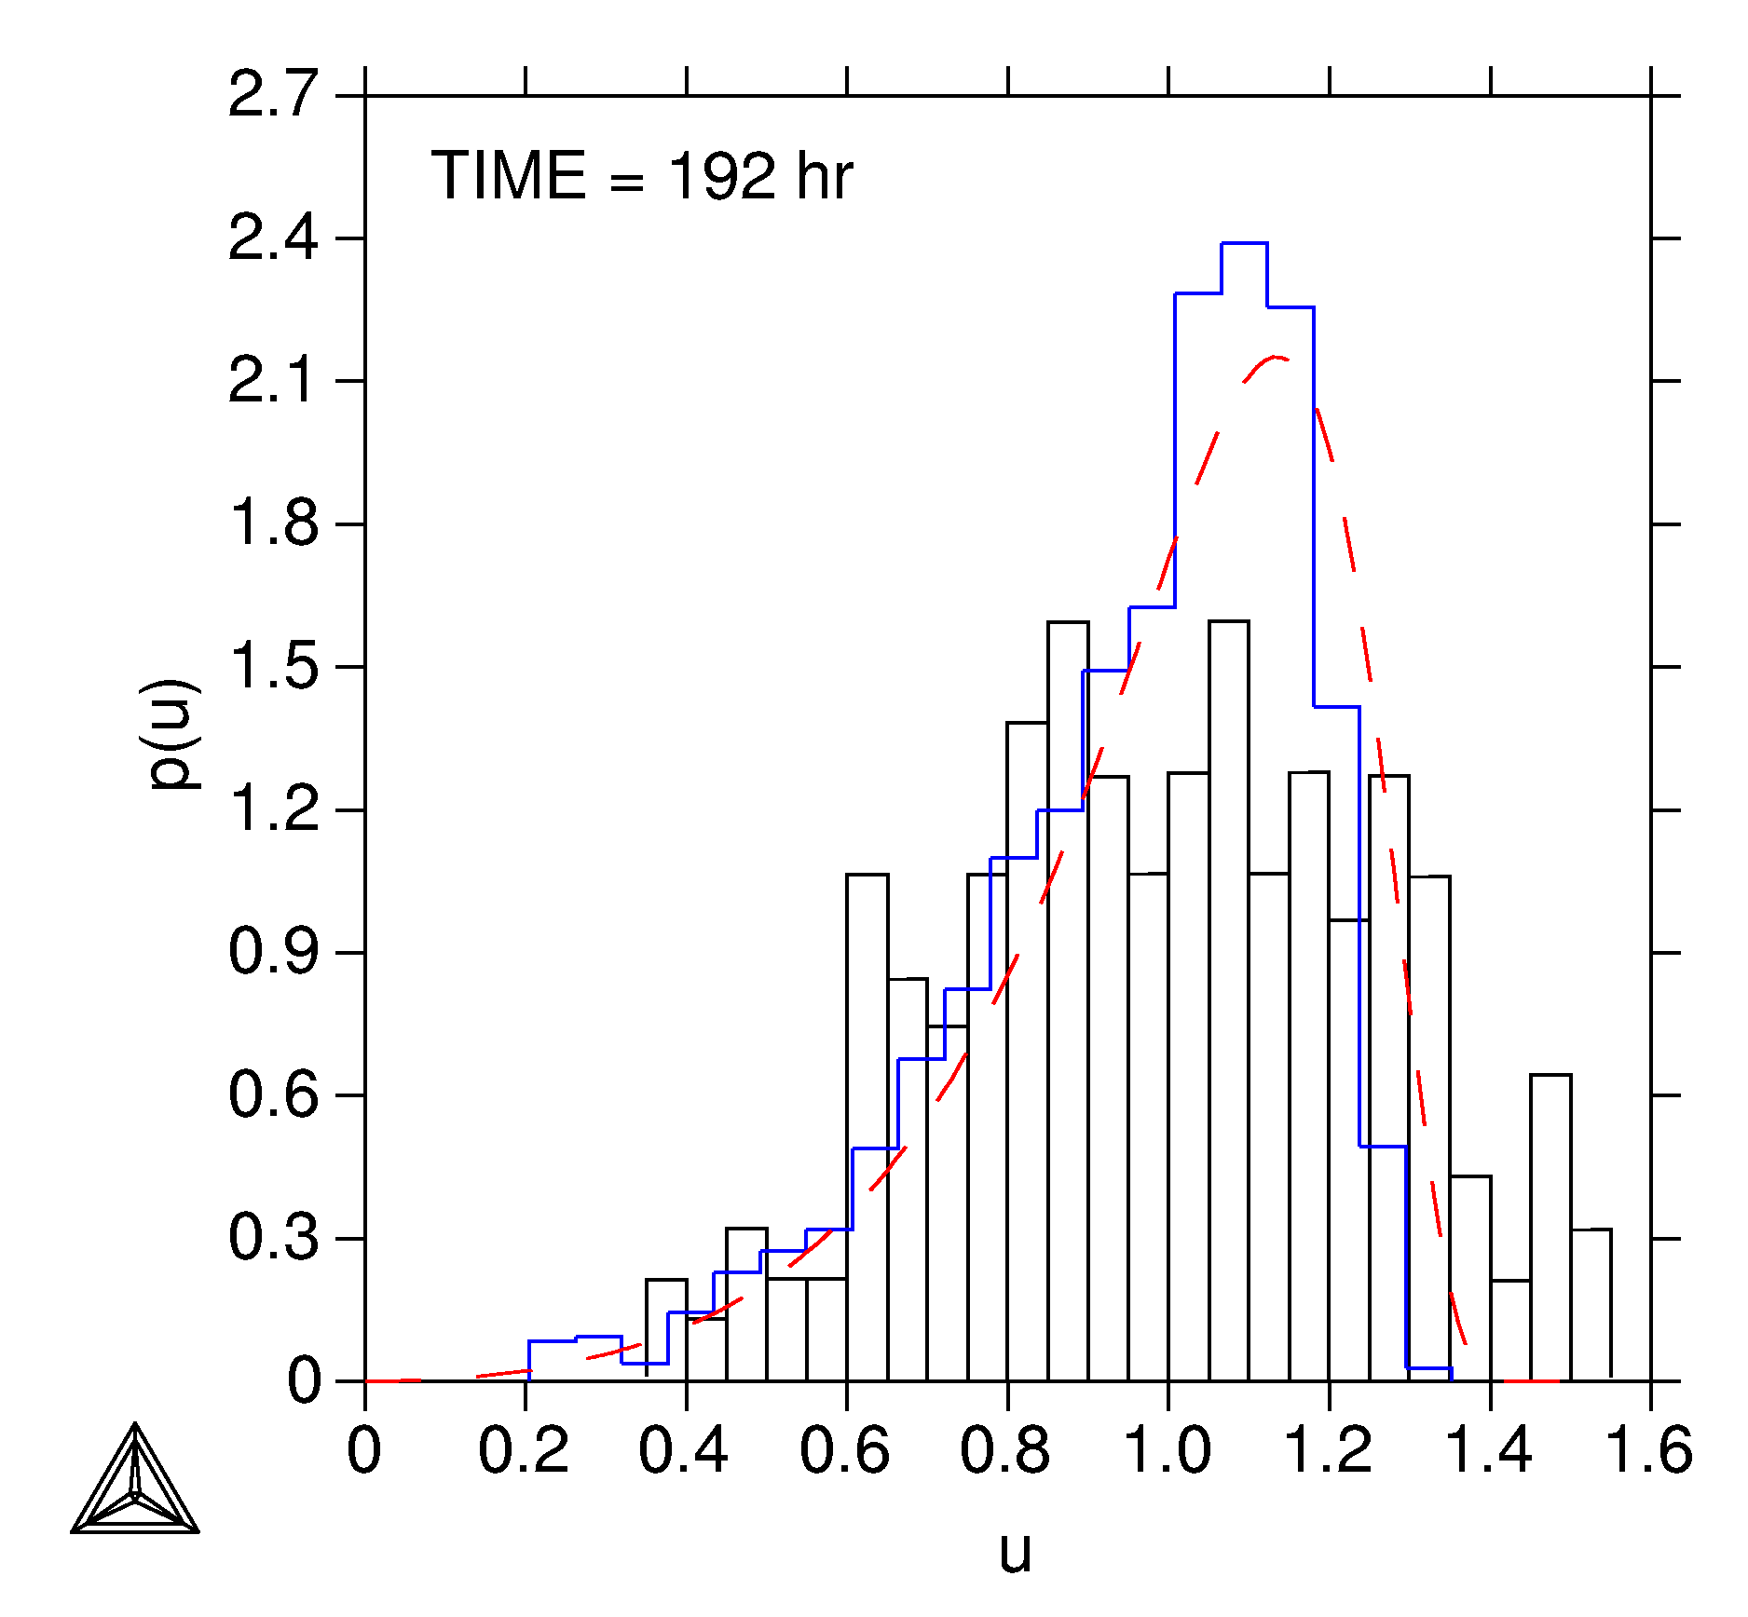
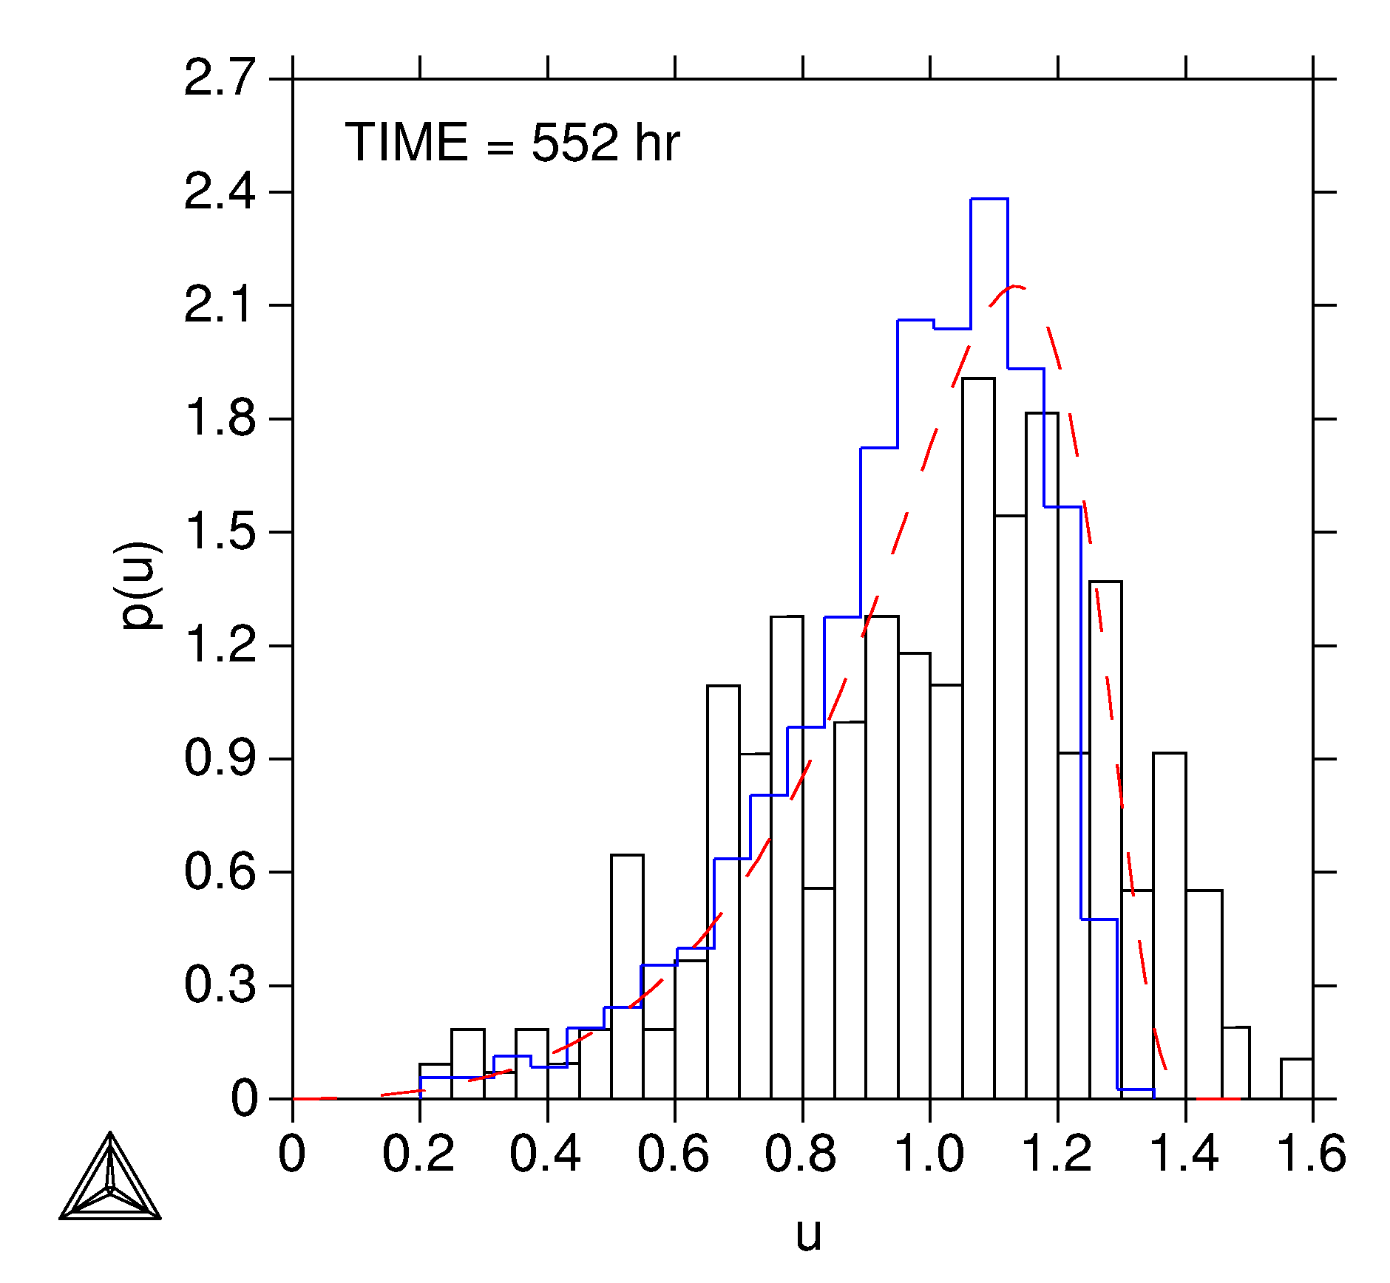
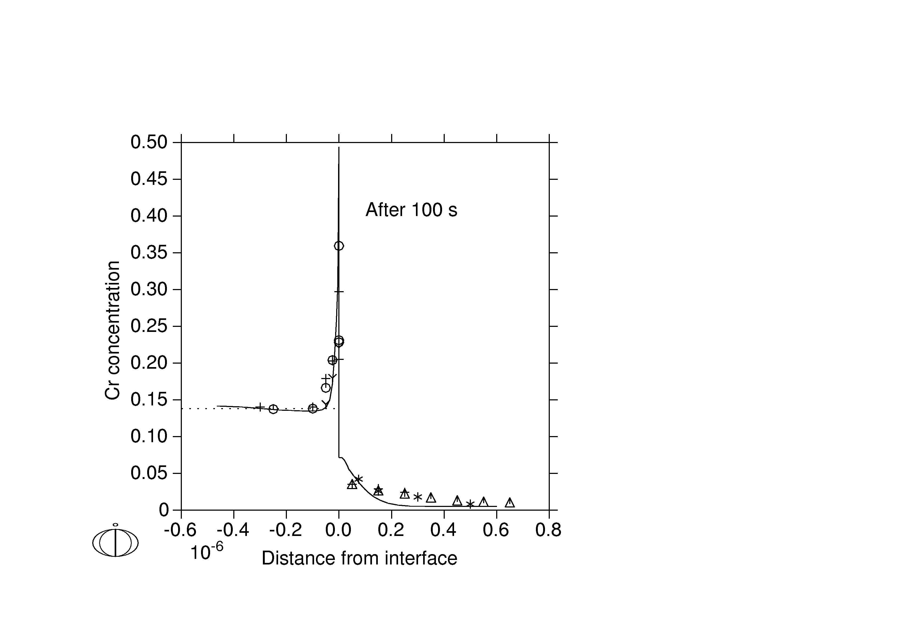
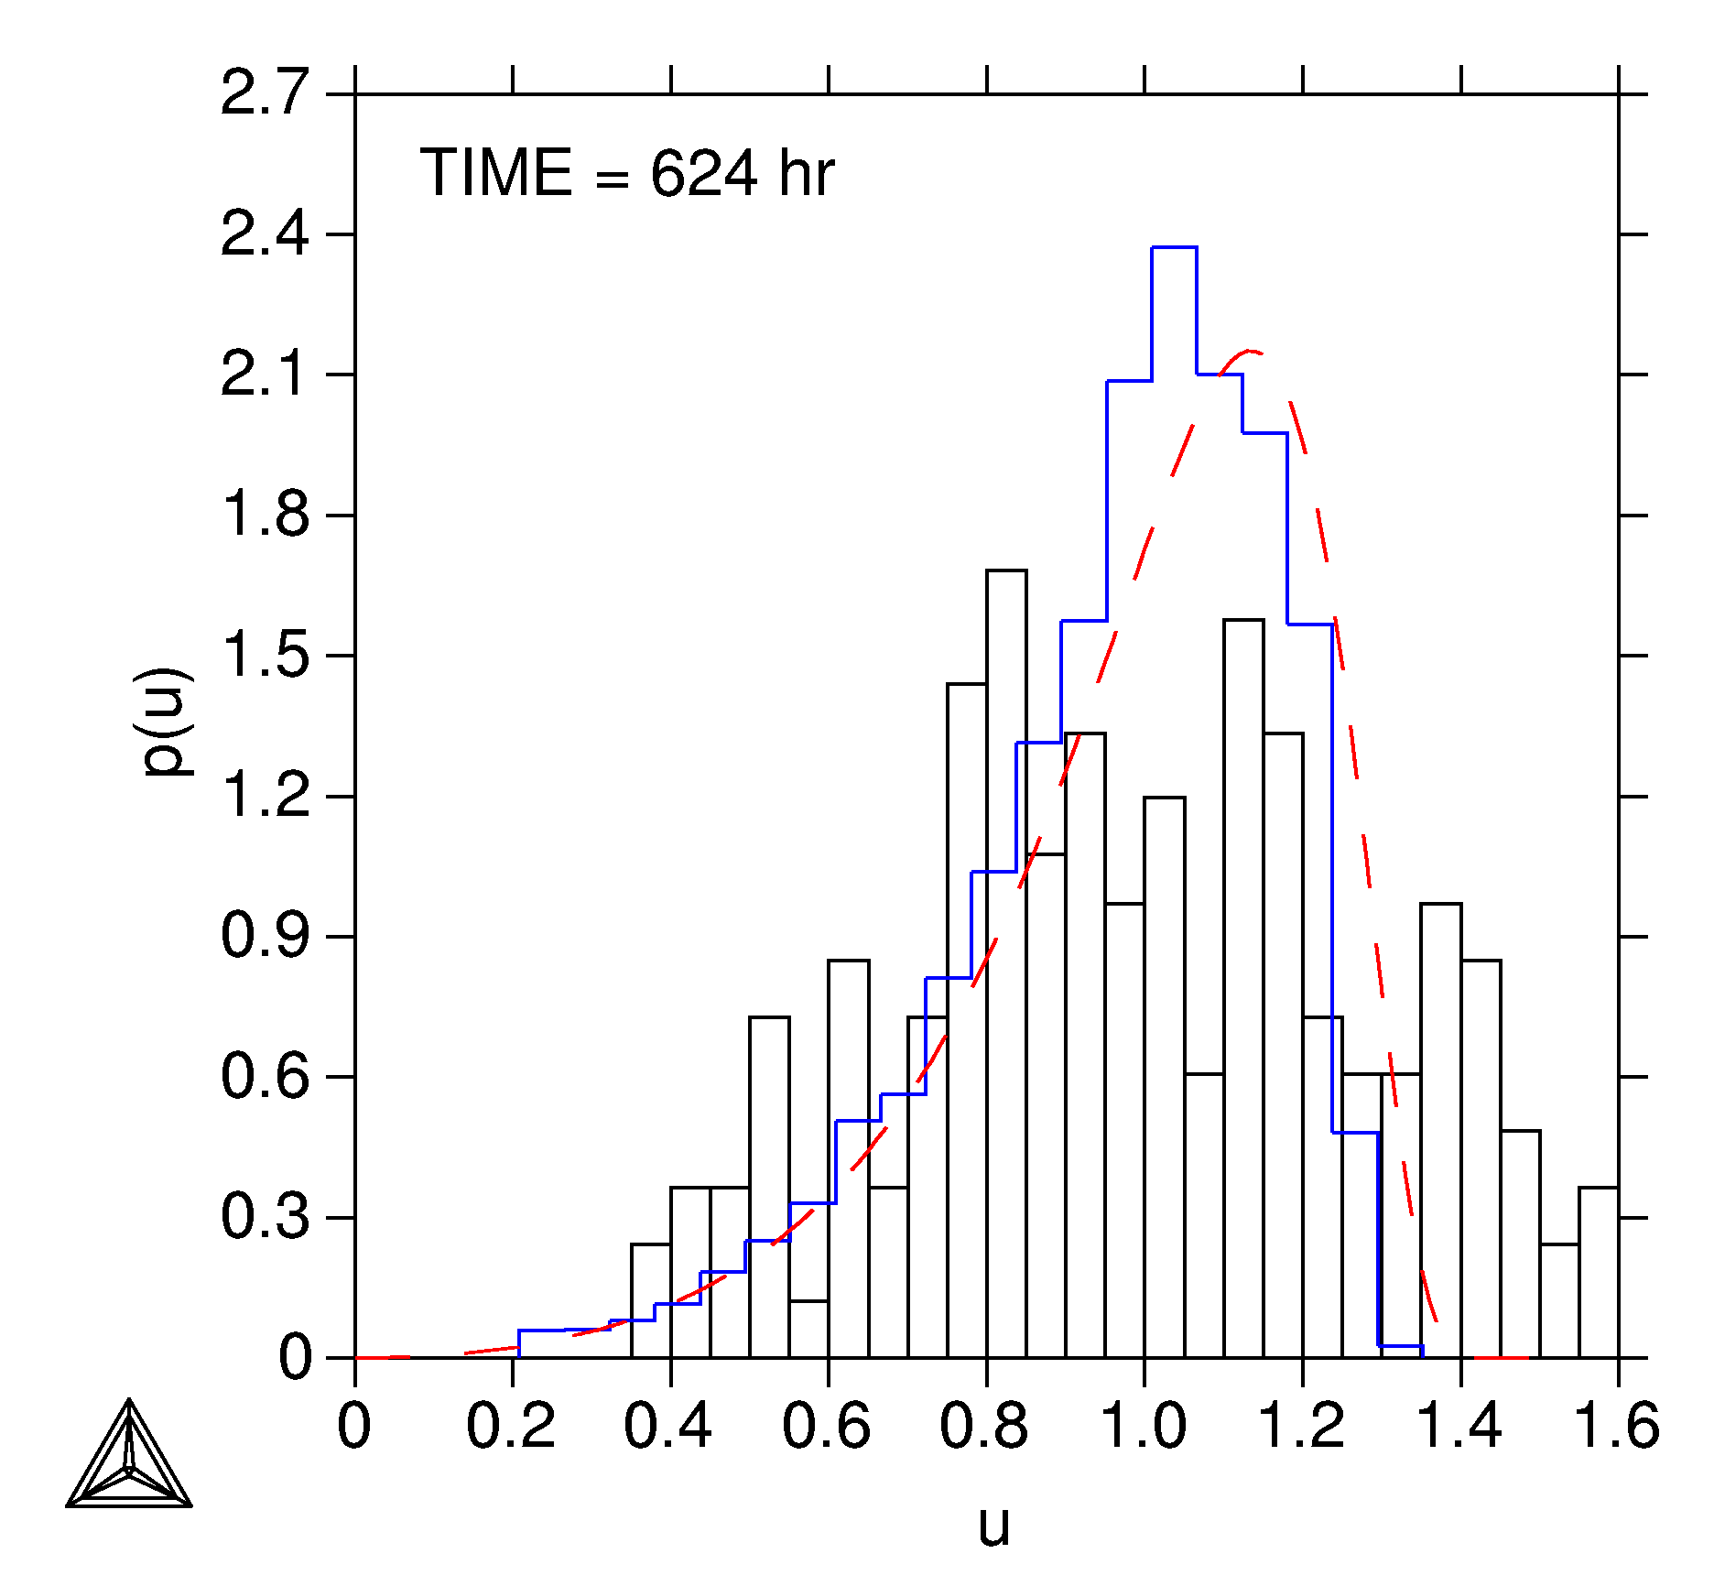
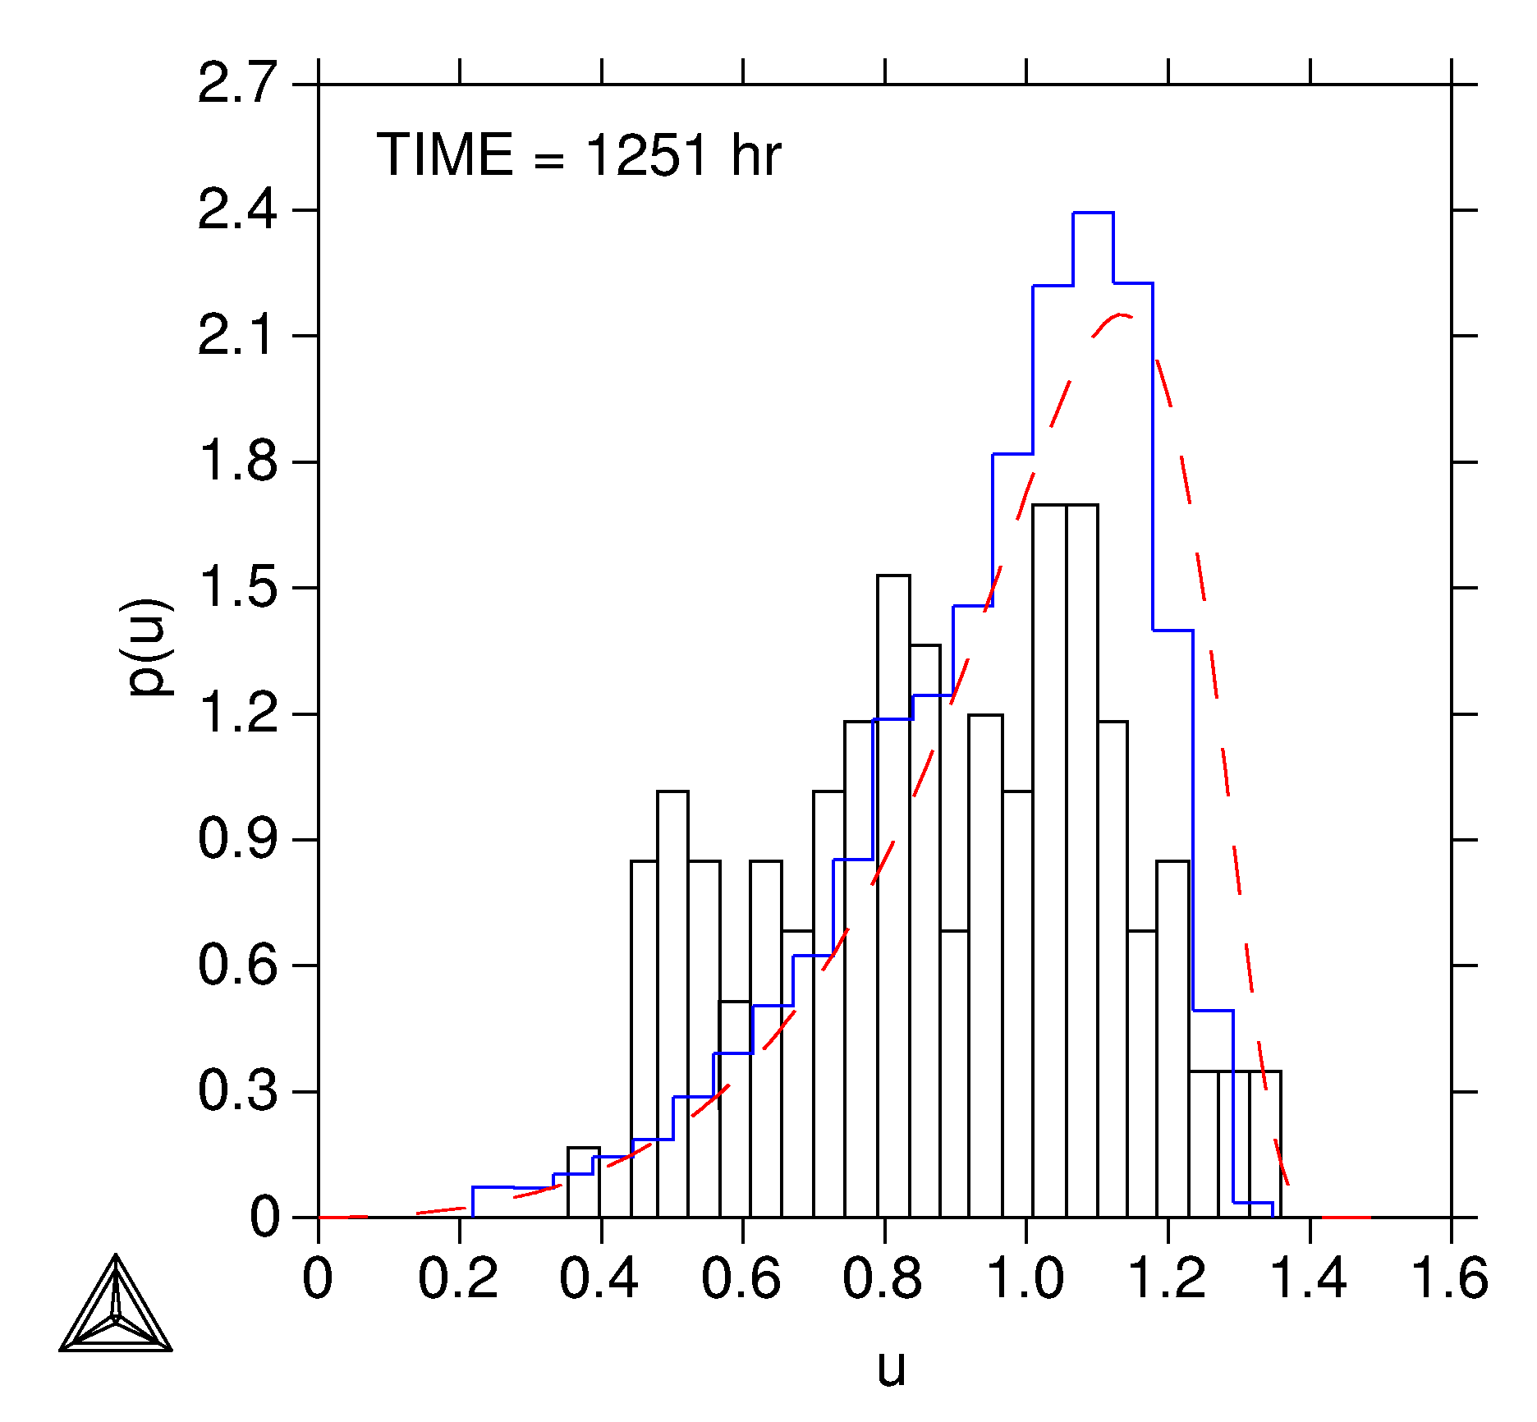
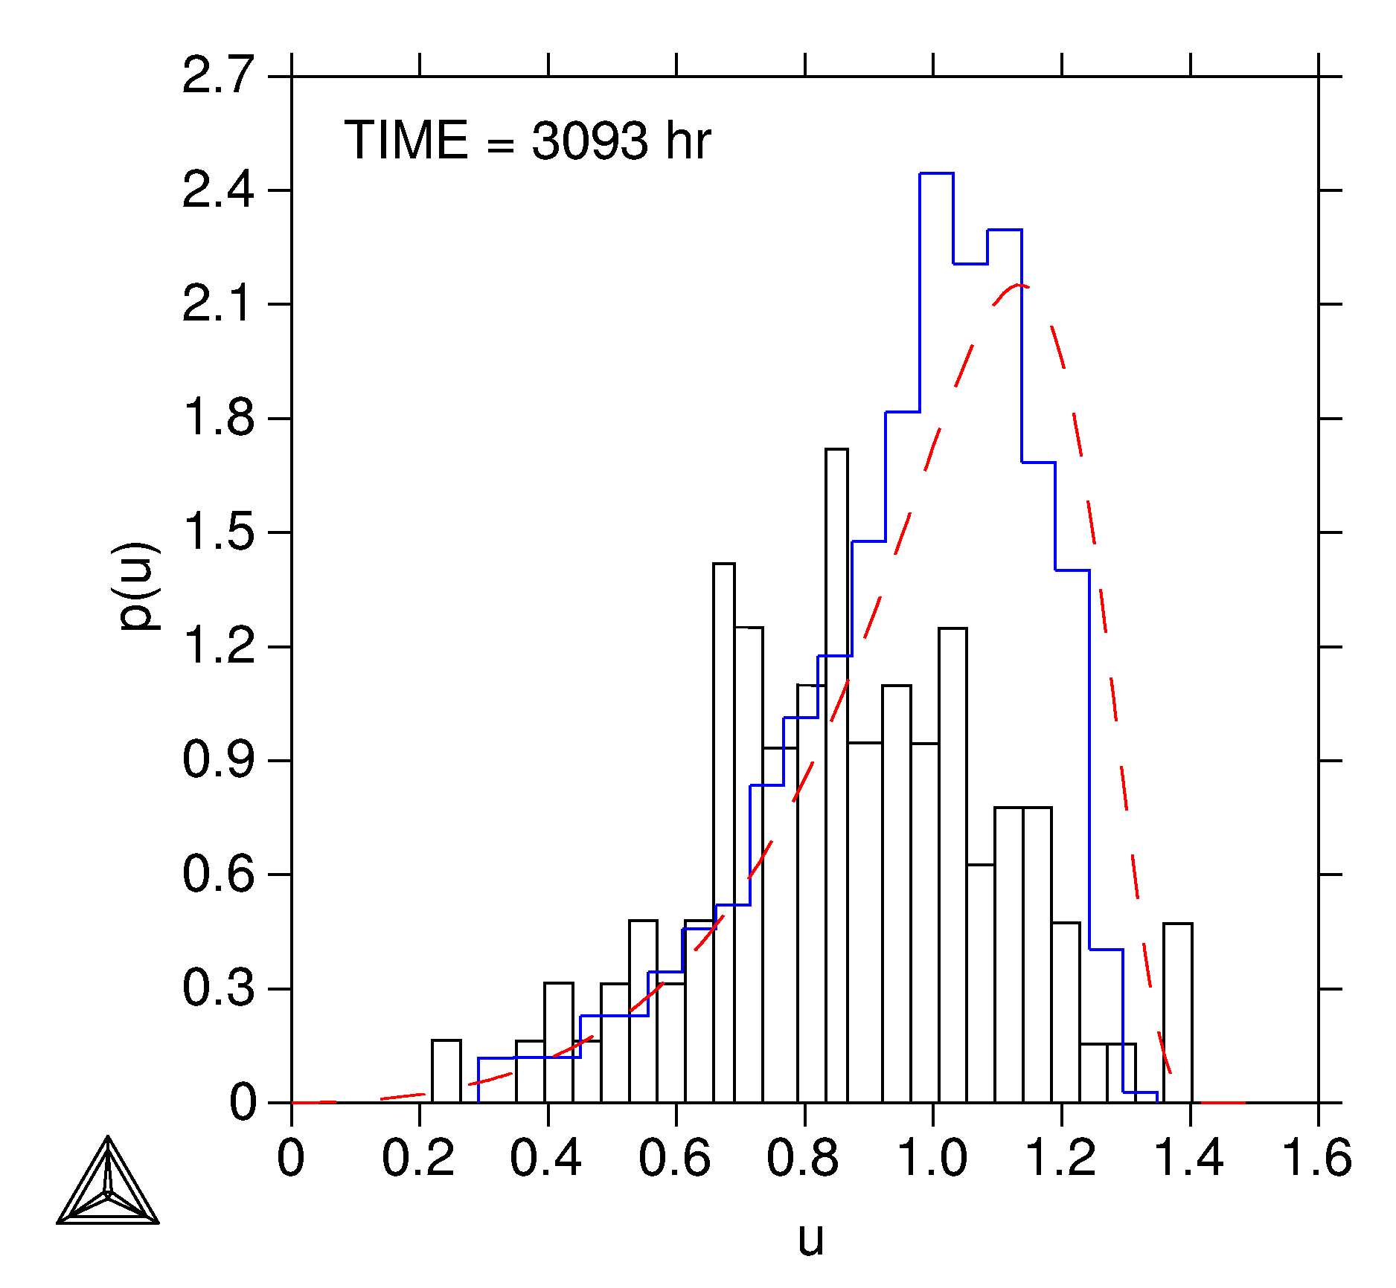
A suite of CALPHAD based software tools
THERMO-CALC
Driving forces
x
Interfacial energies
x
TC-PRISMA
DICTRA
Diffusivities

Slide 13
What is CALPHAD (1)
Thermochemical measurements:
Enthalpy
Entropy
Heat capacity
Activity
Phase equilibria:
Liquidus
Solidus
Phase boundary
Gibbs Energy of Individual Phases
Applications

Slide 14
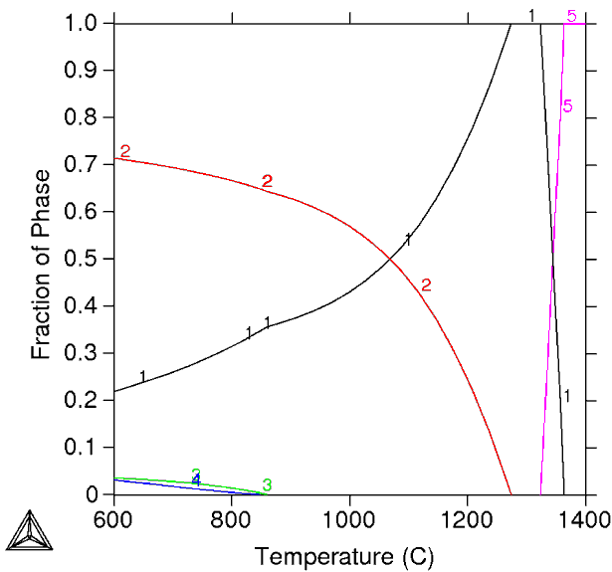
What is CALPHAD (2)
γ’
Thermodynamic
Database
γ
R- and μ-phase
Thermo-Calc
Description of Gibbs free energy for the individual phases
Minimization of the total Gibbs free energy under given conditions.
Result

Slide 15
Thermodynamic databases
A wide range of thermodynamic databases are available for:
➢ Steels and Fe-alloys
➢ Nickel-base superalloys
➢ Aluminium/Titanium/Magnesium-base alloys
➢ Gases, pure inorganic/organic substances, & general alloys
➢ Slag, metallic liquids, and molten salts
➢ Ceramic systems, and hard materials
➢ Semiconductors, and solder alloys
➢ Noble metal alloys
➢ Materials processing, process metallurgical & environmental aspects
➢ Aqueous solutions, materials corrosion & hydrometallurgical systems
➢ Minerals, and geochemical/environmental processes
➢ Nuclear materials, and nuclear fuel/waste processing

Slide 16
TCNI5 – An example of a multicomponent
CALPHAD database
 | Al | B | C | Co | Cr | Fe | Hf | Mo | N | Nb | Ni | Pd | Pt | Re | Si | Ta | Ti | V | W
B | x
C | x | x
Co | x | x | x
Cr | x | x | x | x
Fe | x | x | x | x | x
Hf | x | x | x | x | x | x
Mo | x | x | x | x | x | x | x
N | x | x |  | x | x | x |  | x
Nb | x | x | x | x | x | x | x | x | x
Ni | x | x | x | x | x | x | x | x | x | x
Pd | x | x | x | x | x | x | x | x |  | x | x
Pt | x | x | x | x | x | x | x |  |  | x | x | x
Re | x | x | x | x | x | x | x | x |  | x | x | x | x
Si | x | x | x | x | x | x | x | x | x | x | x | x | x | x
Ta | x | x | x | x | x | x | x | x | x | x | x | x | x | x | x
Ti | x | x | x | x | x | x | x | x | x | x | x | x | x | x | x | x
V | x | x | x | x | x | x | x | x | x | x | x | x | x | x | x | x | x
W | x | x | x | x | x | x | x | x | x | x | x | x | x | x | x | x | x | x
Zr | x | x | x | x | x | x | x | x | x | x | x | x | x | x | x | x | x | x | x
20 + 3 elements.
184 of 190 binary systems assessed for full range composition
Total number of possible ternaries (1140)
All Ni containing ternaries plus other ternary systems also
assessed to full range of composition (184 / 1140 in total)
292 intermetallic and solution phases

Slide 17
CALPHAD based software: Thermo-Calc (1)
Calculating stable and meta-stable heterogeneous phase equilibrium
Amount and composition of phases
Transformation temperatures, e.g. liquidus and solidus temperature
Predicting driving forces for phase transformations
Phase diagrams (binary, ternary, isothermal, isoplethal, etc.)
Molar volume, density and thermal expansion
Scheil-Gulliver (non-equilibrium) solidification simulations
Thermochemical data such as;
enthalpies
heat capacity,
activities, etc.
Thermodynamic properties of chemical reactions
And much, much more….
Designing and optimization of alloys
Design and optimization of processes

Slide 18
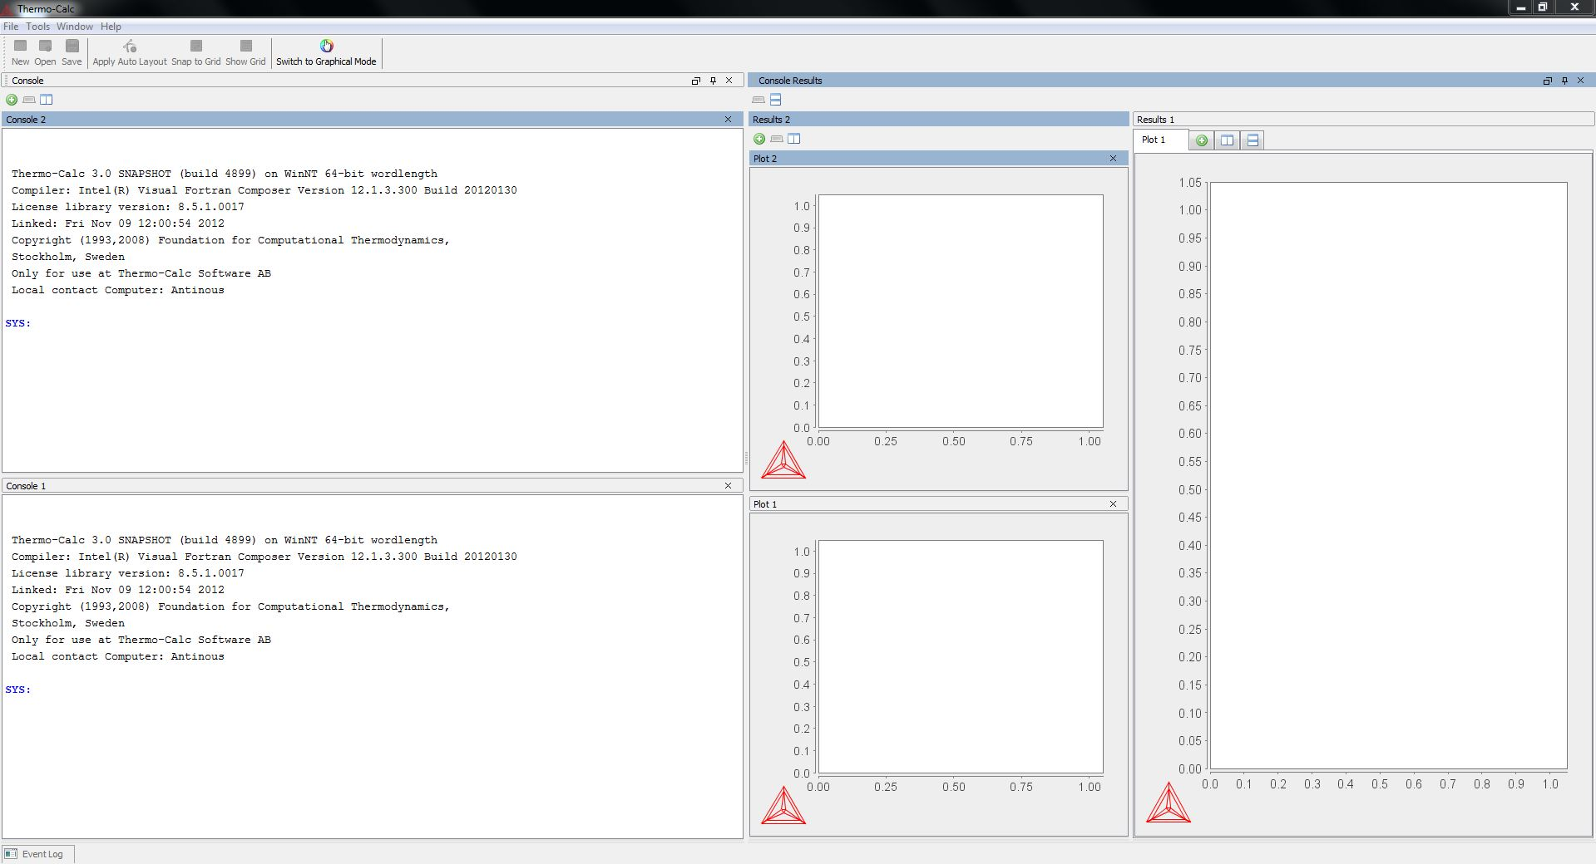
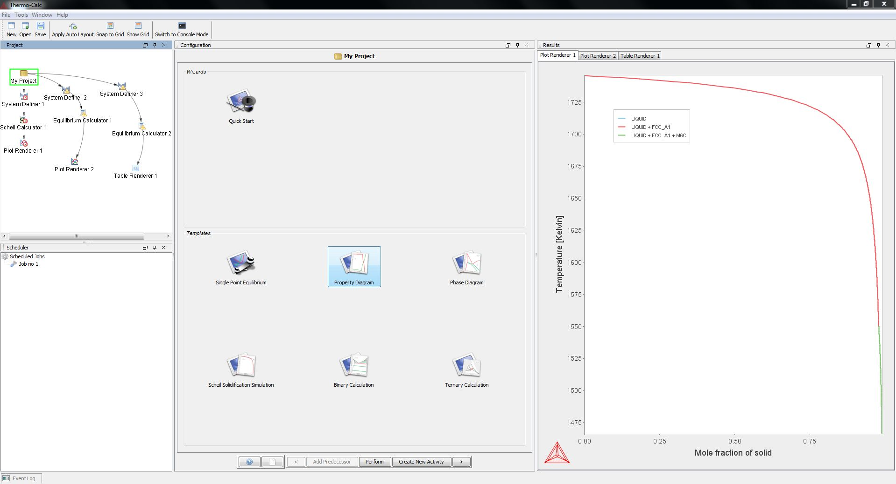
Overview of Thermo-Calc 4.1
Console Mode
Graphical Mode

Slide 19
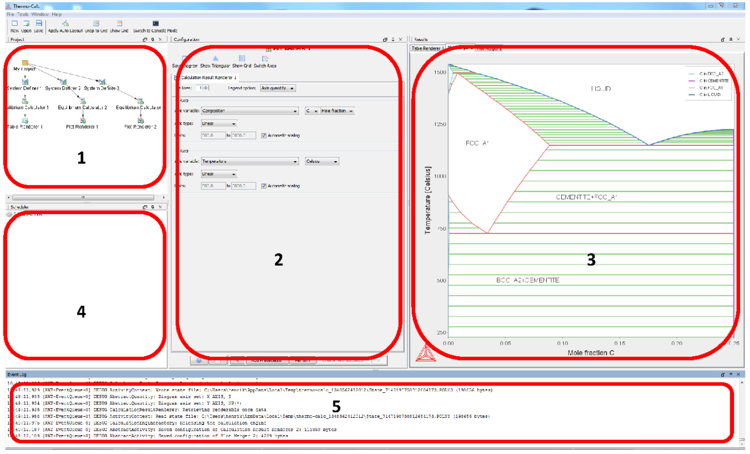
GUI layout
Project window – shows relations between defined activities
Configuration window – for configuring the selected activity
Results window – graphic and text output
Scheduler window – shows performed and scheduled calculations
Event log window – text output of progress

Slide 20
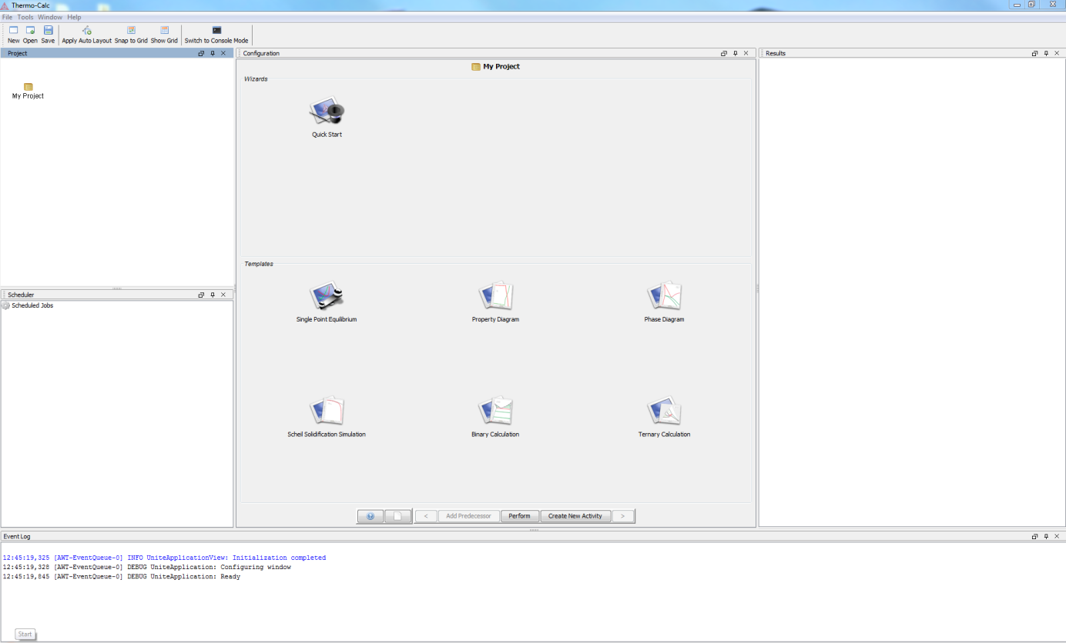
Getting started
”Quick Start”
Step-by-step instructions for common tasks
”Templates”
Sets up the framework for certain specific tasks

Slide 21
GUI layout
Set-up Configure Results
Work flow

Slide 22
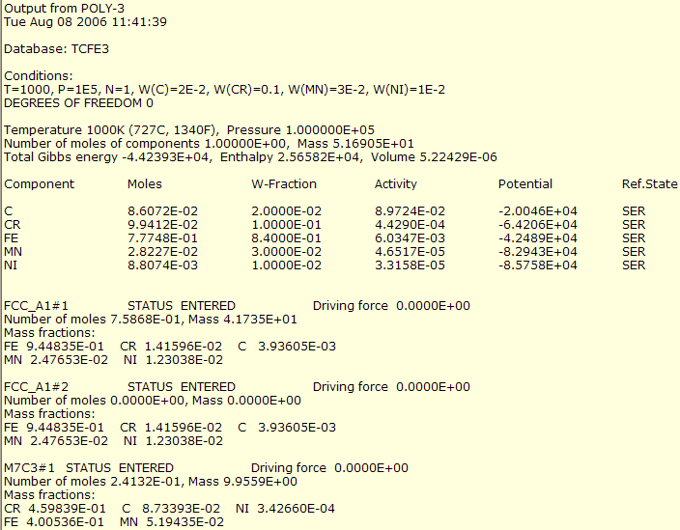
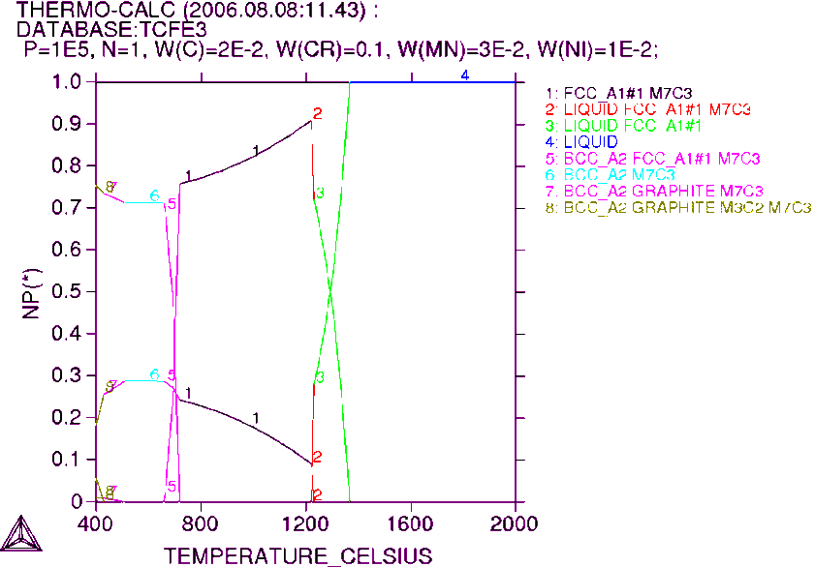
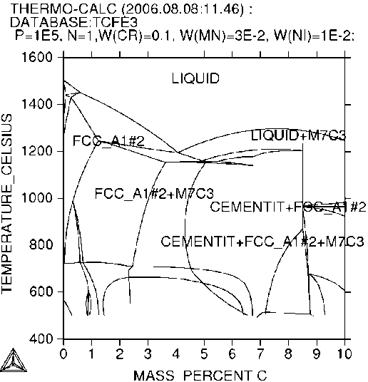
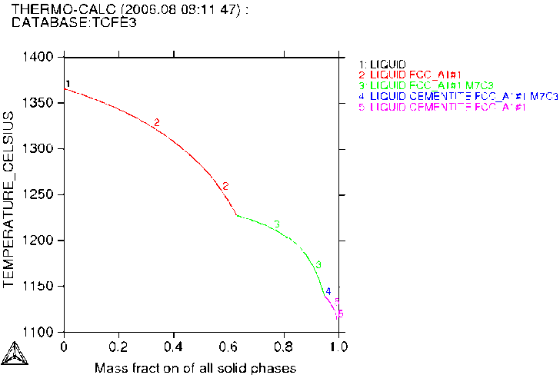
CALPHAD based software: Thermo-Calc (2)
Single Pt Eqm
STEP
MAP
SCHEIL

Slide 23
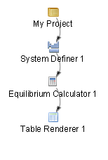
General work flow
Select database
Define the thermodynamic system
Set equilibrium conditions
View results

Slide 24
Single point equilibrium
Use the ”Quick Start”
Calculate the equilibrium state for a steel under the following conditions:
22 Cr 5.5 Ni 3 Mo 0.14 N (bal. Fe) [mass-%] at 1000°C
A system size of 1 mole and atmospheric pressure is assumed

Slide 25
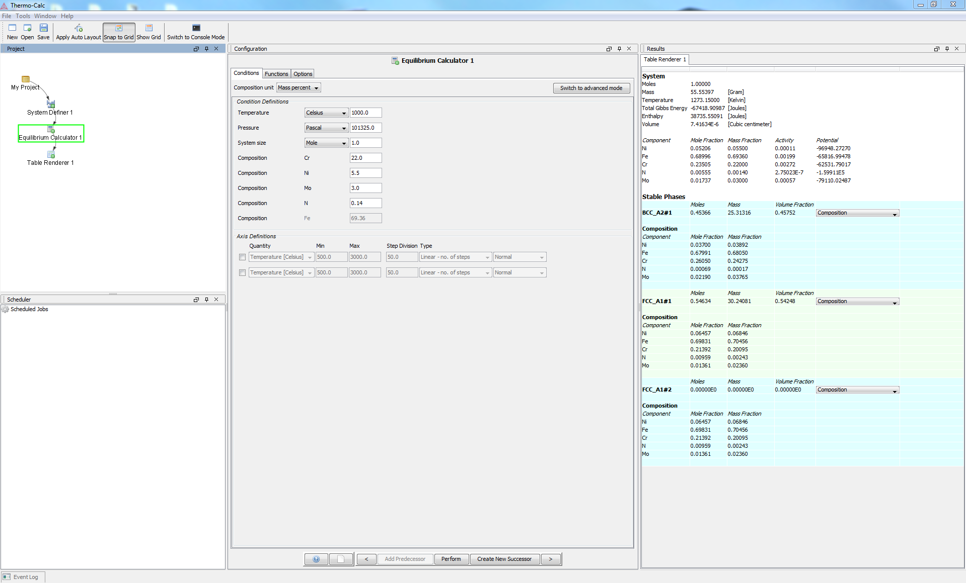
Single point equilibrium

Slide 26
Single point equilibrium
”activities”

Slide 27
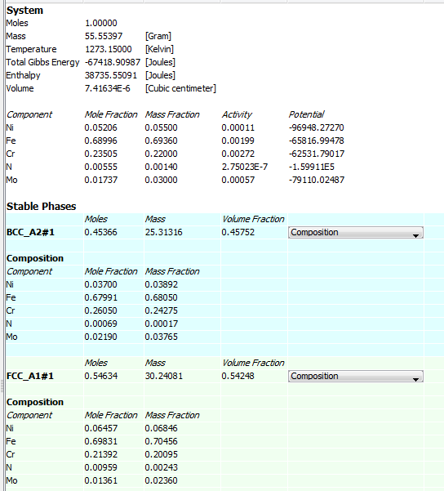
Single point equilibrium

Slide 28
Early example using thermodynamic calcs in alloy design
The first systematic use of of Calphad computational tools and databases for industrial purposes. Based only on equilibrium calculations.
In 1983 Swedish steel producer Sandvik developed a new generation of duplex stainless steels.
–Same price level as the conventional 18/8 steel
–Twice the strength
–Better corrosion resistance
–Reduced experimental costs (2 instead of 10 years)
Most important to have 50/50 mixture of FCC-BCC.
Avoid TCP (e.g. sigma phase)
Same PRE-number in both phases. PRE (Pitting Resistance Equivalent) calculated empirically from phase composition.
Slide courtesy of Prof. J. Ågren, KTH

Slide 29
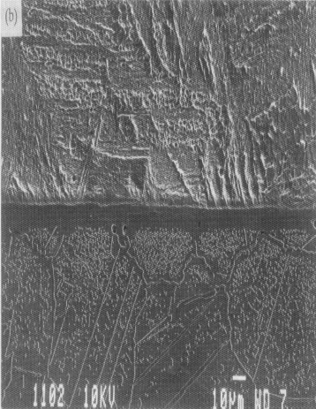
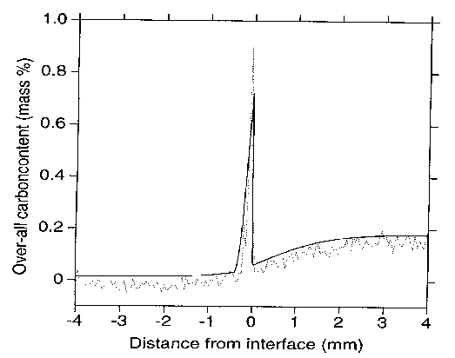
CALPHAD based software: DICTRA
A general software package for simulation of DIffusion Controlled TRAnsformations in multi component alloys.
The result of more than 20 years and 60 man-years R&D at:
Royal Institute of Technology (KTH) in Stockholm, Sweden Max-Planck Institute für Eisenforschung in Düsseldorf, Germany
Example: Interdiffusion in compound
Emphasis has been placed on linking fundamental methods to critically assessed thermodynamic and kinetic data, allowing simulations and predictions to be performed with realistic conditions on alloys of practical importance.
Helander et al., ISIJ Int. 37(1997), pp. 1139-45

Slide 30
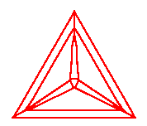
CALPHAD based software: DICTRA (2)
All simulations depend on assessed kinetic and thermodynamic data.
Solve Diffusion
where
Boundary conditions
(External or Internal)
Diffusivities
Gibbs Energy
Mobilities
Kinetic
DATABASES
Thermodynamic
A numerical finite difference scheme is used for solving a system of coupled parabolic partial differential equations.

Slide 31
Diffusion rates are needed
Modelling must apply in multicomponent systems because the real alloys are multicomponent. Many diffusion coefficients!
Various type of coupling effects may make it more complicated than Fick’s law.
Details of geometry not of primary importance.
An approach in the Calphad spirit was suggested for information on diffusion kinetics (Andersson-Ågren 1992)
– Allowed systematic representatation of the kinetic behaviour of multicomponent alloy systems.
DICTRA was developed in the 1990s for numerical solution of multicomponent diffusion problems in simple geomtries.
Slide courtesy of Prof. J. Ågren, KTH

Slide 32
Available Kinetic Databases
Mobility databases are currently available for:
Steels and Fe-alloys
Nickel-base superalloys
Aluminium alloys
Titanium alloys
Symbols are experimental data taken from Minamino et al. Science and technology of advanced materials 2000;1:237-249.
-11.5
1573
1523
-12.0
1473
1423
1373
-12.5
1323
1273
-13.0
LOGDC(FCC,AL,AL,NI)
-13.5
-14.0
Symbols are experimental data taken from Campbell et al, Materials Sci & Eng A 407(2005), pp. 135-146.
-14.5
-15.0
0
0.05
0.10
0.15
0.20
Mole-Fraction Al
Symbols are experimental data taken from Yamamoto et al, Trans. Jpn. Inst. Met. 21(1980), p. 601.

Slide 33
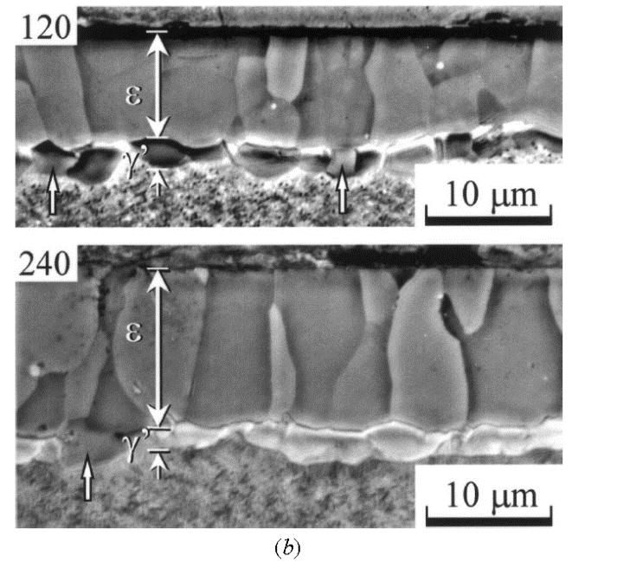
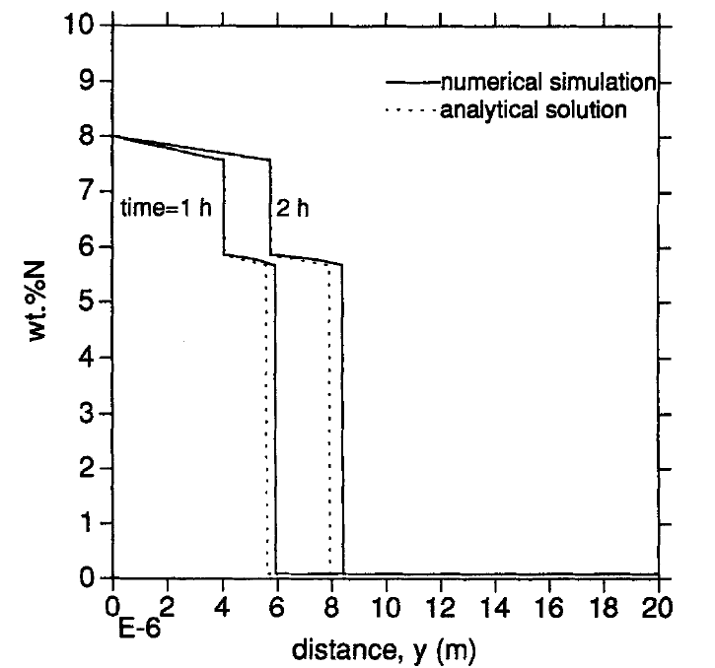
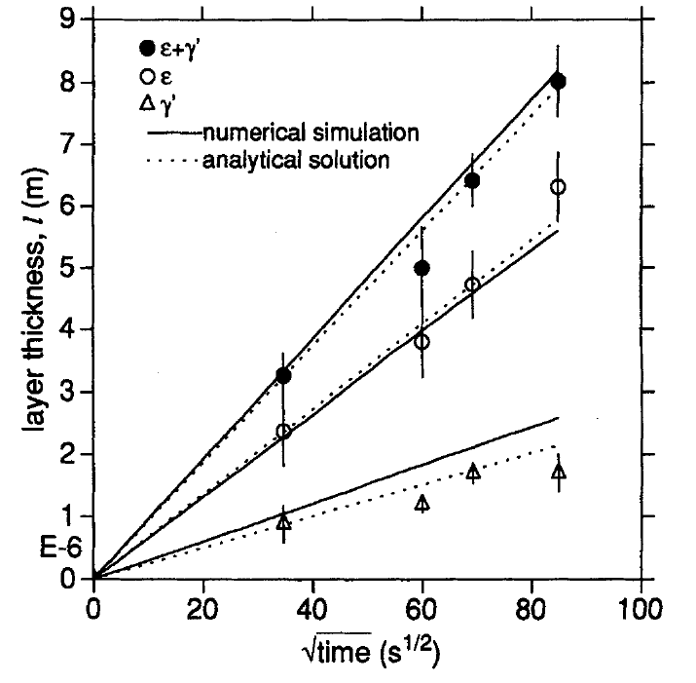
Example of thermodynamics + diffusion - Nitriding
Nitride formation at steel surface during nitriding of steel:
(Du et al. 1996, 1998)
A surface modification process with many advantages. How thick are the surface layers?

Slide 34
CALPHAD based software: TC-PRISMA (1)
Concurrent nucleation, growth/dissolution, coarsening using a mean field approach.
THERMO-CALC
Particle Size Distribution
Number Density
Average Particle Radius
Volume Fraction
TTT/CCT
Average Compositions
Interface Compositions
Nucleation Rate
Critical Radius
TCPRISMA
X_{i} & T(t)
DICTRA

Slide 35
The need for interfacial energies
The length scale is typically determined by a combination of thermodynamic driving forces, interfacial energy, diffusion and the dynamic nature of the process.
Modelling and databases for interfacial energy needed.
In the simplest case interfacial energy is just a number (which may be difficult to determine experimentally but could be obtained from e.g. coarsening studies). Because of uncertainty could be treated as a calibration factor.

Slide 36
CALPHAD based software: TC-PRISMA (2)
Classic Nucleation Theory
Grain size, dislocation density, etc
Interfacial energy
Volume

Slide 37
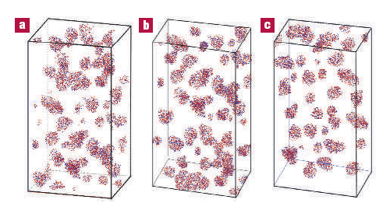
TC-PRISMA Examples: Ni-based superalloy (1)
Booth-Morrison et al. Acta Mater. 56(2008) 3422-3438
Sudbrack et al. Acta Mater. 56(2008)448-463
Sudbrack et al. Acta Mater. 54(2006)3199-3210
Ni-9.8Al-8.3Cr
Ni-9.7Al-8.5Cr-2W
Ni-7.5Al-8.5Cr
Ni-5.2Al-14.2Cr
s = 0.023 J/m²
Thermo-Calc and Dictra Databases
γ’
γ’
γ’
1273 K
1363 K
1173 K
Mao et al, Nature materials, 6(2007)210-216
1573 K
(~90 K + Solvus)
20 hr
1073 K, 873 K
24 hr
0.5 hr
3 hr
~ 264 hr, ~ 1024 hr

Slide 38
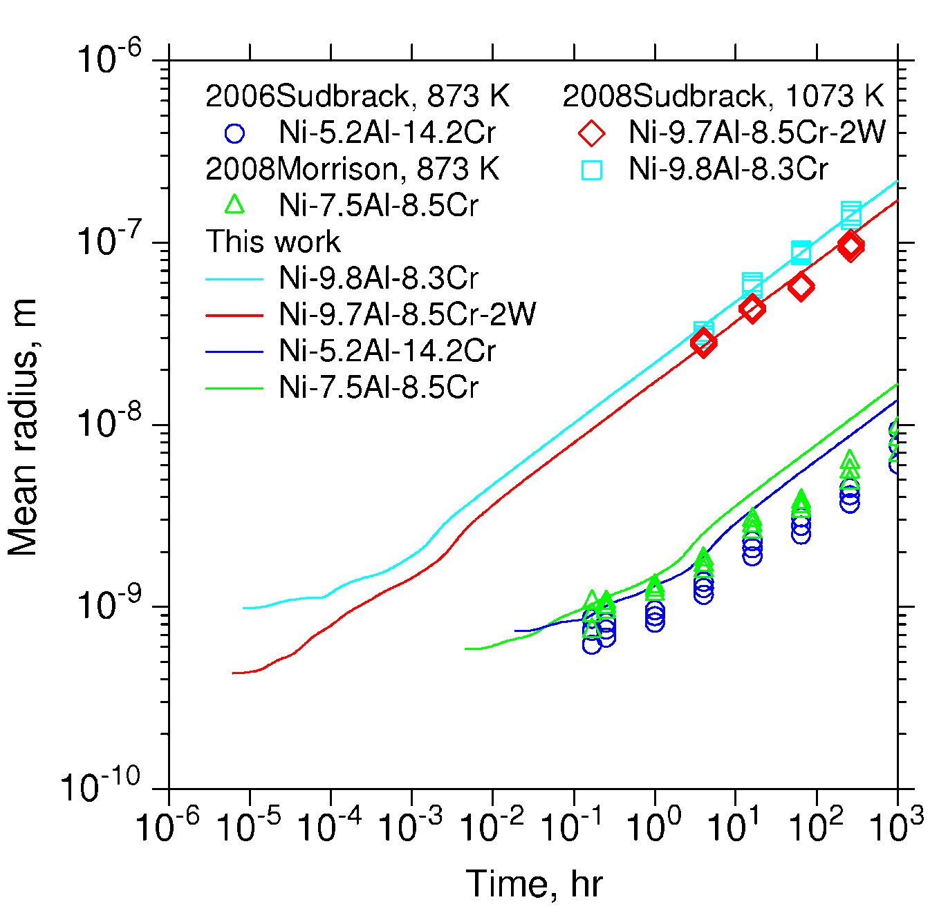
TC-PRISMA Examples: Ni-based superalloy (2) – Mean radius

Slide 39
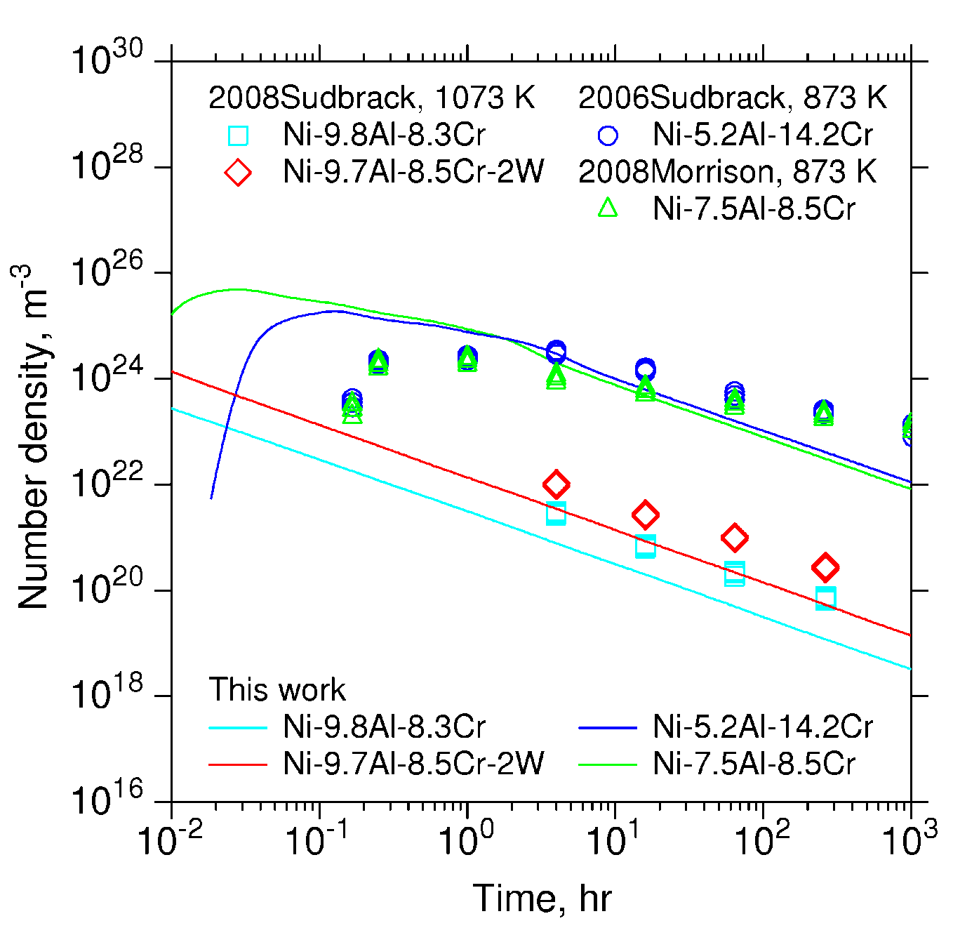
TC-PRISMA Examples: Ni-based superalloy (3) – Number density

Slide 40
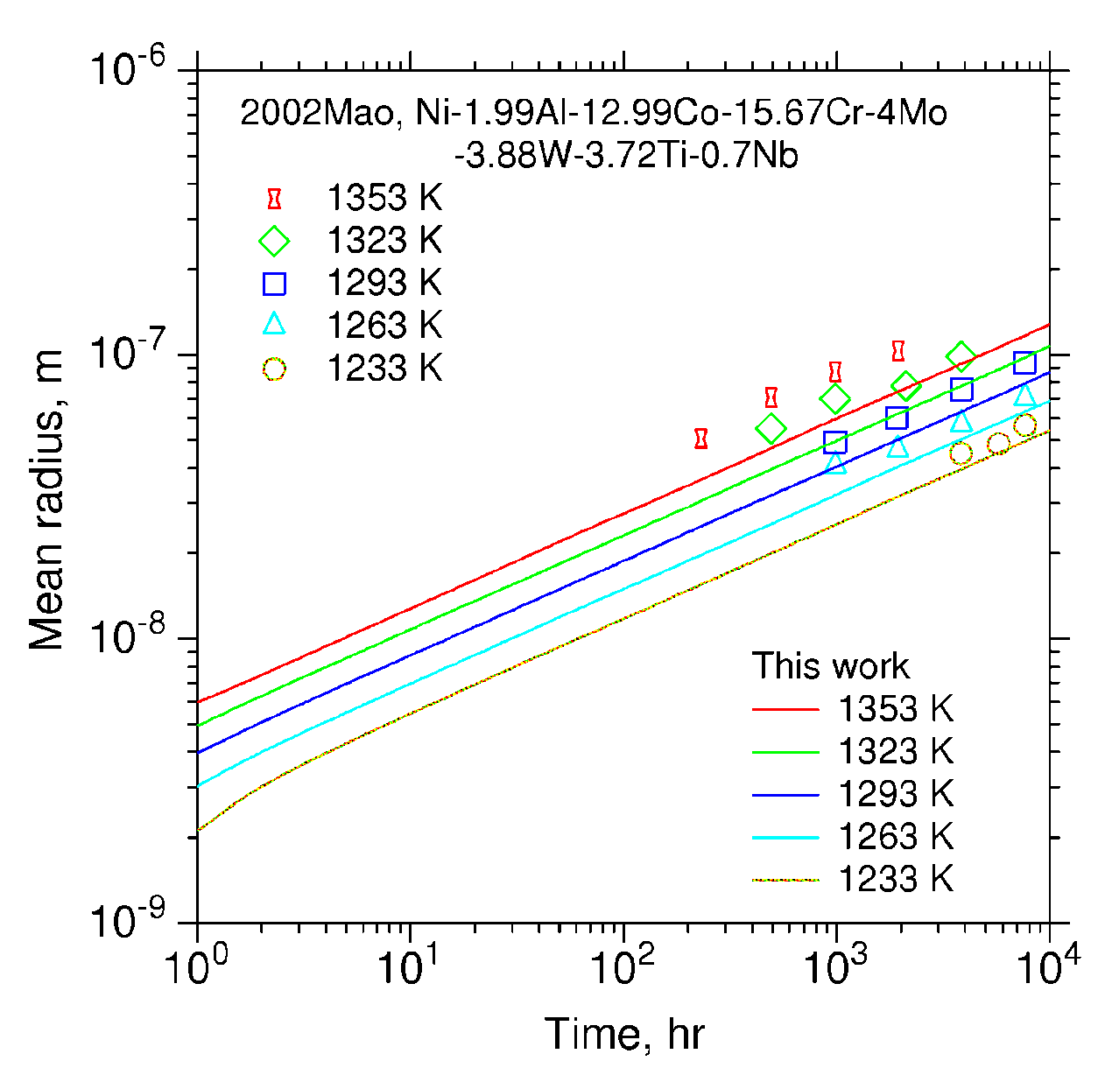
TC-PRISMA Examples: Ni-based superalloy (4) – Rene88DT
Change only system and use same set of physical parameters

Slide 41
TC-PRISMA Examples: Particle size distribution

Slide 42
CALPHAD based software: Phase field (1)
Output:
  Detailed morphology
  Concentration fields
  Stress fields
  Plastic strain fields (dislocation density fields)
  ...
Need or can use input from
  Multicomponent thermodynamics
  Multicomponent diffusion analysis
  Interfacial energy and mobility
  Elastic coefficients and stresses
  Stress-free transformation strain tensor (eigen strains)
  Plastic relaxation
  Fluid flow (Navier Stokes)
  ....
Slide courtesy of Prof. J. Ågren, KTH

Slide 43
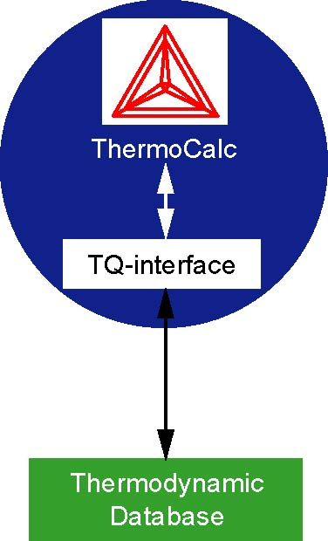
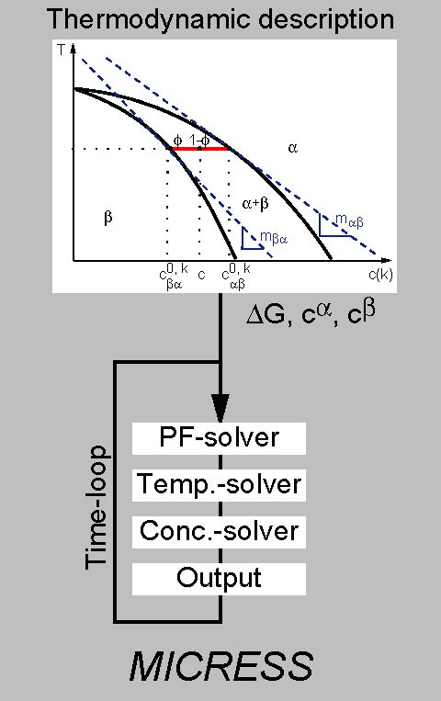

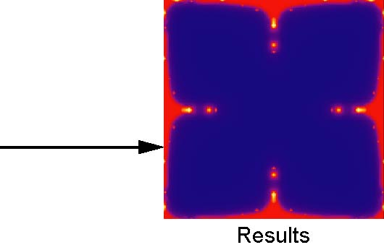
CALPHAD based software: Phase field (2)
Slide courtesy of Dr. Georg J. Schmitz, ACCESS
Mobility
Database

Slide 44
The underlying principles
Of CALPHAD and
Thermo-Calc

Slide 45
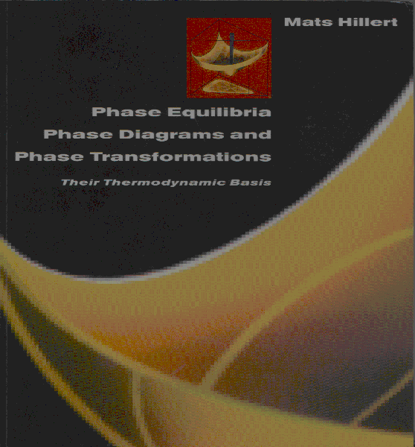
Thermodynamics
ISBN 978-0-521-85351-4

Slide 46
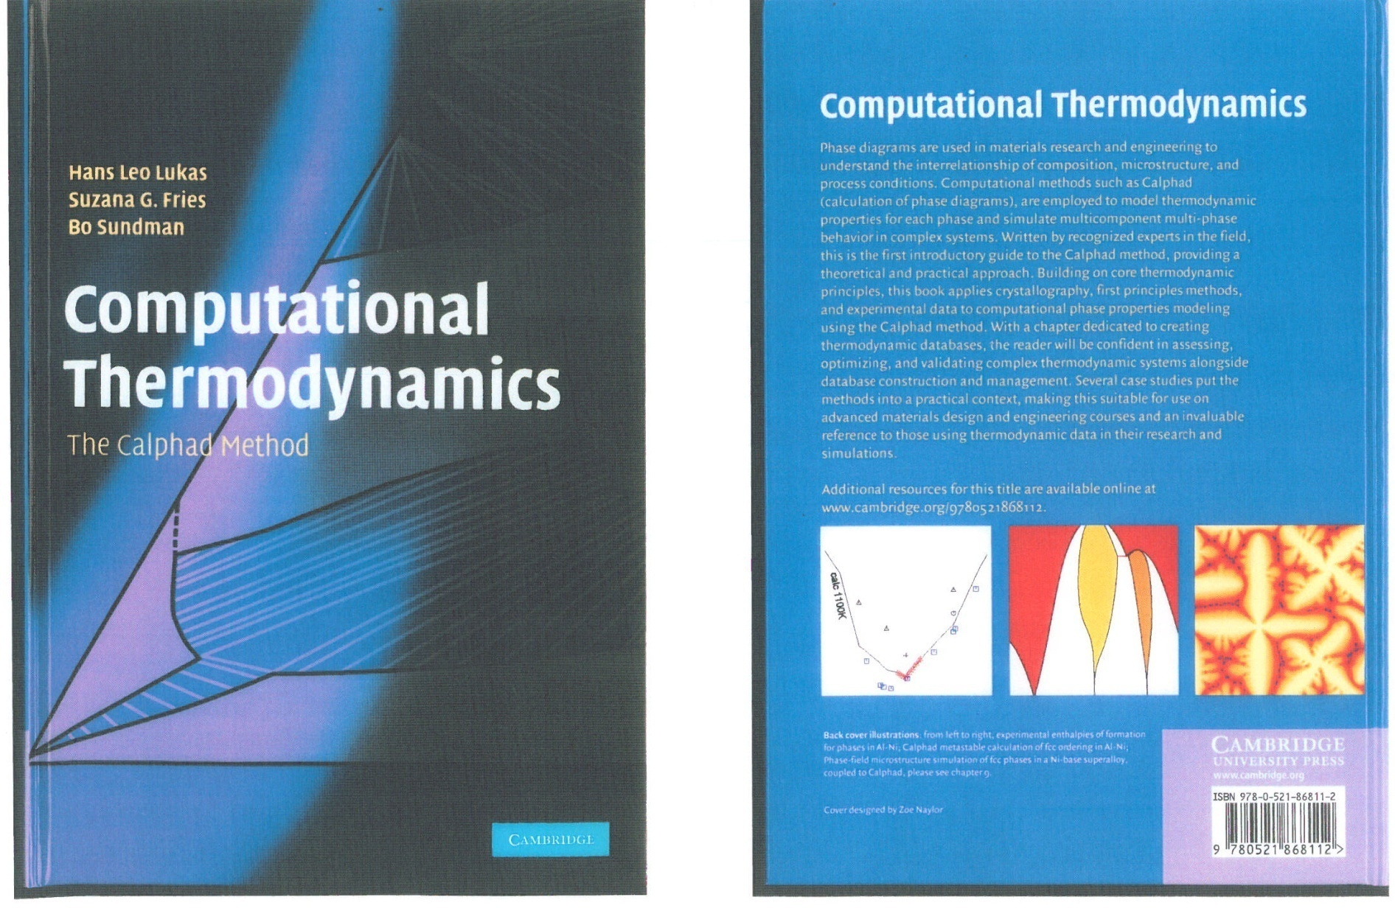
Assessment guide
ISBN 978-0-521-86811

Slide 47
Behind Thermo-Calc
Thermodynamic Databases (The CALPHAD approach)
Thermochemical measurements:
Enthalpy
Entropy
Heat capacity
Activity
Phase equilibria:
Liquidus
Solidus
Phase boundary
Gibbs Energy of Individual Phases
Applications

Slide 48
CALPHAD Methodology
Fundamental
Theory
Empirical
Rules
Experimental
Data
Models
Experimental Determination
Ab Initio Calculation
Parameter
Optimization
Database
Thermodynamic Properties
Equilibrium States
Phase Diagrams

Slide 49
Thermodynamic Modeling
Reference state
Pure elements/substances
Gibbs energy relative to a standard element reference state (SER), i.e. the enthalpy of the element in its stable state at 298.15K and 0.1MPa. GHSERFE means the Gibbs energy of FE under SER state.
Entropy at 0K = 0 (+TS(0))
Needed because there is no absolute value of the enthalpy of a system and one must select some reference state.
For a reference state, one can change its phase structure, temperature, and pressure.

Slide 50
Thermodynamic Modeling
Gibbs energy per mole for a solution phase is normally divided in:
excess term
reference surface
physical contribution
configurational contribution
Ideal solution model
Regular solution model
Real solution

Slide 51
Binary - Ideal Solution Model
For a A-B binary solution phase: (A,B)

Slide 52
Binary - Regular solution model

Slide 53
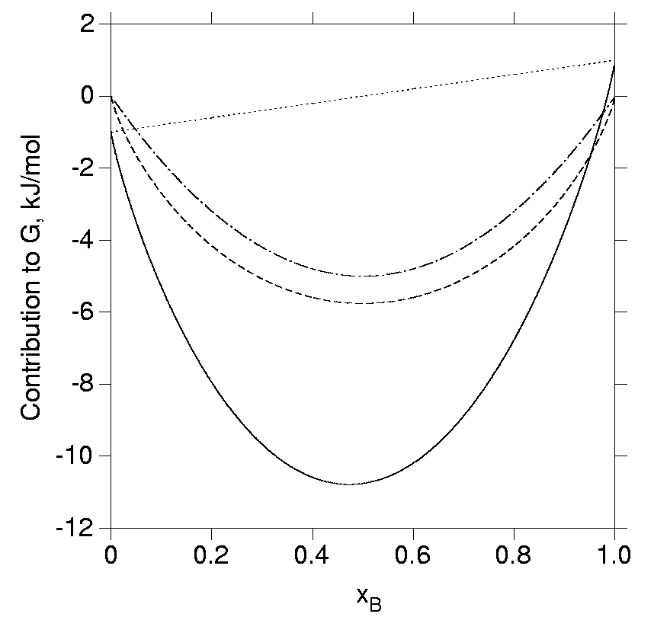

Slide 54
Binary - Real solutions
Redlich-Kister Expansion

Slide 55
Ternary solutions
From Binary
From Ternary

Slide 56
Thermodynamic models
Thermodynamic models handle EOS & all kinds of thermodynamic properties for various systems. Some of the available models are:
Component-Energy Model (interaction on up to ten sublattices):
  Redlich-Kister polynomials (Muggianu or Kohler extrapolation)
  Stoichiometric constraints
  Interstitial solution
  Chemical ordering
  Ionic constituents
Two-Sublattice Ionic Liquid Model
Associated Model
Quasi-chemical Model
Kapoor-Frohberg Cell Model
Inden Model for magnetic ordering
CVM (Cluster Variation Methods) for chemical ordering
Birch-Murnagham Model (pressure-dependency) for minerals/alloys
SUPERFLUID Model for C-H-O-S-N-Ar fluid & gaseous mixtures
DHLL, SIT, HKF and PITZ Models for aqueous solutions
Flory-Huggins Model for polymers

Slide 57
Compound Energy Formalism (CEF)
The sublattice model has been used extensively to describe interstitial solutions, carbides, oxides, intermetallic phases etc.
It is often called the compound energy formalism (CEF) as one of its features is the assumption that the compound energies are independent of composition. It includes several models as special cases.
Note that the G_{m} for sublattice phases is usually expressed in moles for formula units, not moles of atoms as vacancies may be constituents.

Slide 58
Simple Binary Example of CEF

Slide 59
Simple Binary Example of CEF
PARAMETER G(HCP_A3,CO:VA;0) 298.15 +GHSERCO;,,N !
PARAMETER G(HCP_A3,NI:VA;0) 298.15 +GHCPNI;,,N !
FUNCTION GHSERCO 298.15 +310.241+133.36601*T
-25.0861*T*LN(T)-.002654739*T**2-1.7348E-07*T**3
+72527*T**(-1) 1768.0 Y -17197.666+253.28374*T
-40.5*T*LN(T)+9.3488E+30*T**(-9);,, N !
FUNCTION GHSERNI 298.15 -5179.159+117.854*T
-22.096*T*LN(T)-.0048407*T**2;
1728.0 Y -27840.655+279.135*T-43.1*T*LN(T)
+1.12754E+31*T**(-9);,, N !
PARAMETER L(HCP_A3,CO,NI:VA;0) 298.15 -1620-.385*T;,,N !
PARAMETER TC(HCP_A3,CO:VA;0) 298.15 +1396;,,N !
PARAMETER BMAGN(HCP_A3,CO:VA;0) 298.15 1.35;,,N !
PARAMETER TC(HCP_A3,NI:VA;0) 298.15 633;,,N !
PARAMETER BMAGN(HCP_A3,NI:VA;0) 298.15 .52;,,N !
PARAMETER TC(HCP_A3,CO,NI:VA;0) 298.15 411;,,N !
PARAMETER TC(HCP_A3,CO,NI:VA;1) 298.15 -99;,,N!
PARAMETER BMAGN(HCP_A3,CO,NI:VA;0) 298.15 1.046;,,N !
PARAMETER BMAGN(HCP_A3,CO,NI:VA;1) 298.15 .165;,,N !

Slide 60
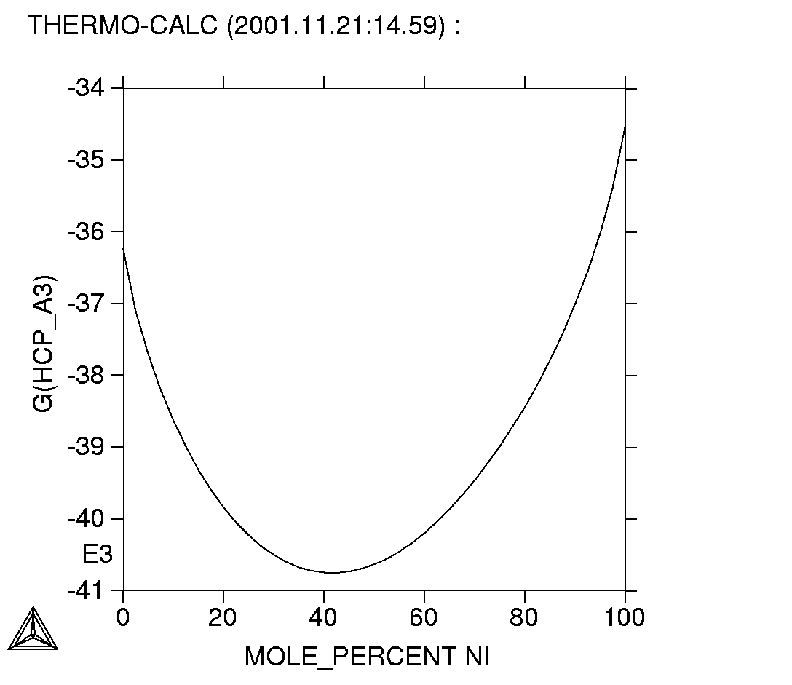
Simple Binary Example of CEF
G of hcp in Co-Ni
Co
Ni

Slide 61
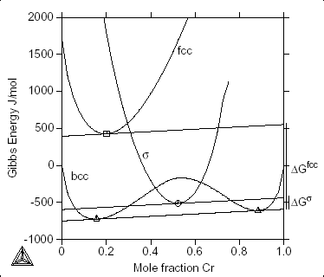
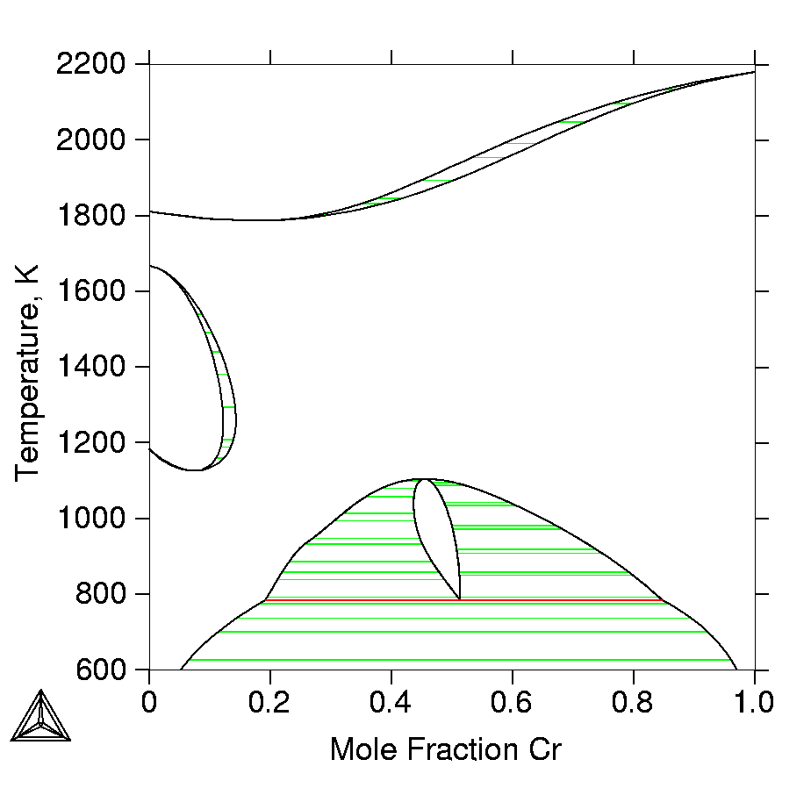
Fe-Cr at 750 K: Gibbs Energy

Slide 62
Thermodynamic Databases
Databases are produced by critical assessment of experimental data and optimization of model parameters (the CALPHAD method).
PARROT in Thermo-Calc Classic can be used as a tool in this process.
Description of the Gibbs energy for each phase Gφ=Gφ(x,T,P) is stored in the database

Slide 63
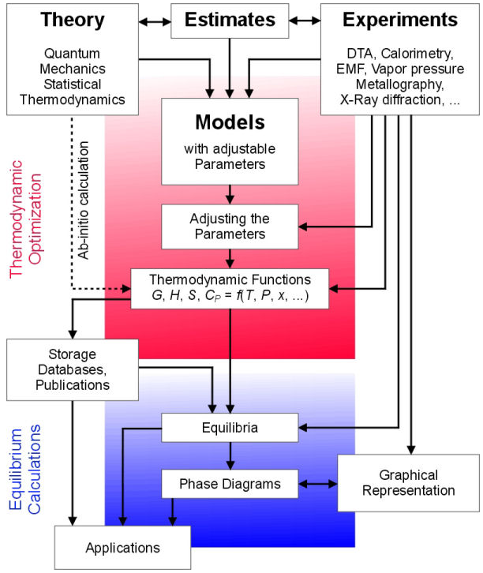
The CALPHAD method.

Slide 64
CALPHAD Method
Thermochemical data
Calorimetric data – Enthalpy of formation, Enthalpy of mixing, Enthalpy of transformation
EMF, Knudsen cell data – Chemical potentials, Activities
Partial pressure – Activities
DSC – Heat content, Heat capacity, Enthalpy of transformation

Slide 65
CALPHAD Method
Phase diagram data
Thermal analysis – Start and end temperatures of transformation
Microscope – Identification of phases, amount of phases
X-ray – Phase identification, lattice parameters
Microprobe – Phase identification, composition of phases
X-ray and neutron diffraction – site occupancy

Slide 66
Sources of thermodynamic data
Two types of data
  Basic thermodynamic and phase equilibrium data – the building blocks of thermodynamic databases
    Experimental
      Phase equilibrium (phase diagrams) for binary and ternary system (liquidus/solidus/phase boundary)
      Thermodynamic data for compounds/stoichiometric phases
      Activity measurements etc
    Theoretical
      Estimation and Ab initio calculations
  Higher order (multi-component data) – validation for alloys etc
    Experimental
      Cp, liquidus/solidus/phase boundary data etc for “real” alloys
      Volume fraction of carbides etc

Slide 67
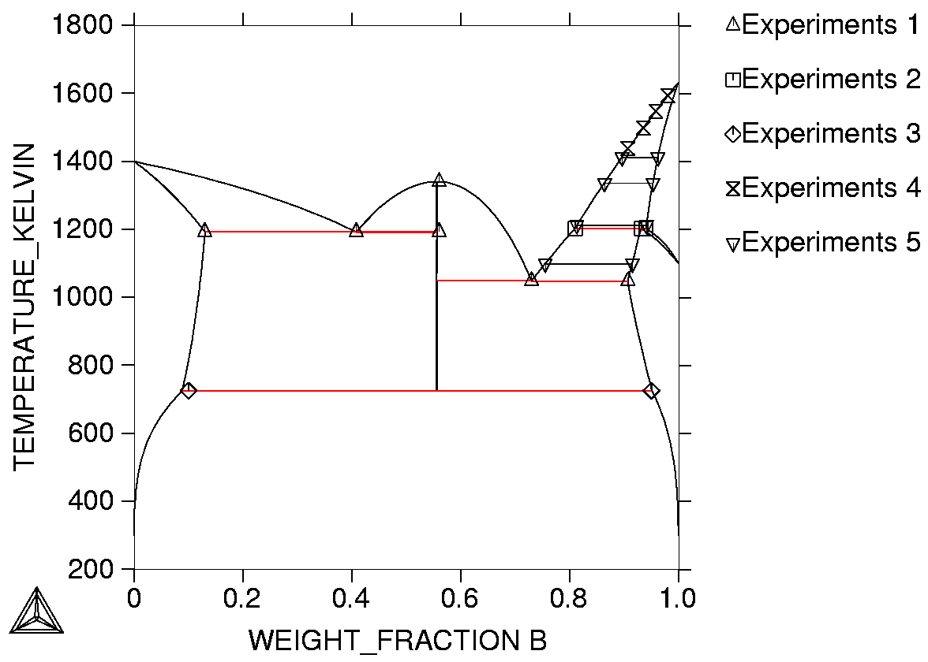
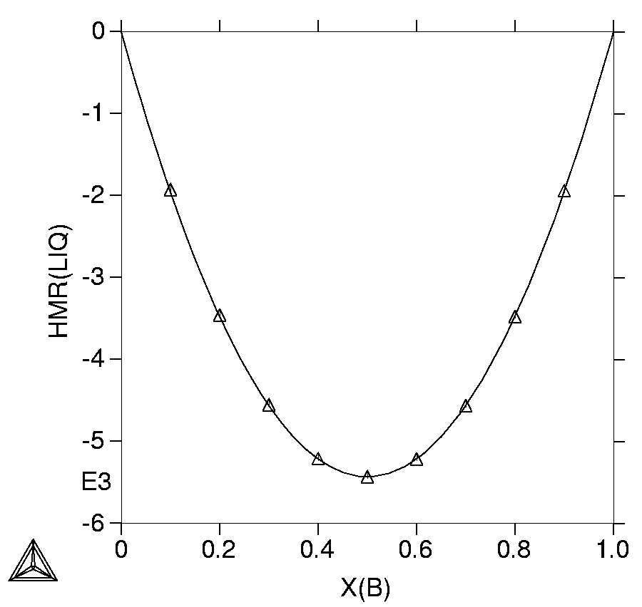
Binary and ternary systems
Normally collected from the literature
Reliable data is selected and critically assessed
Both phase diagram data or thermodynamic data (ΔH,C_{p}...) can be used
Hm(Liquid)

Slide 68
Higher order systems: Real alloys for validation
From: Saunders & Miedownik: ”Calphad -a comprehensive review”

Slide 69
Lattice parameter of Ni-base alloy
Density and Lattice parameter
Density of steels
Notes:
The data are for room temperature. The discrepancy is within 1%.

Slide 70
Density of Carbon Steel
0.11 wt% C, 0.1 wt% Si, 0.48 wt% Mn, 0.02 wt% P
fcc+MnS
fcc
liquid

Slide 71
Examples of applications related to
the materials life cycle

Slide 72
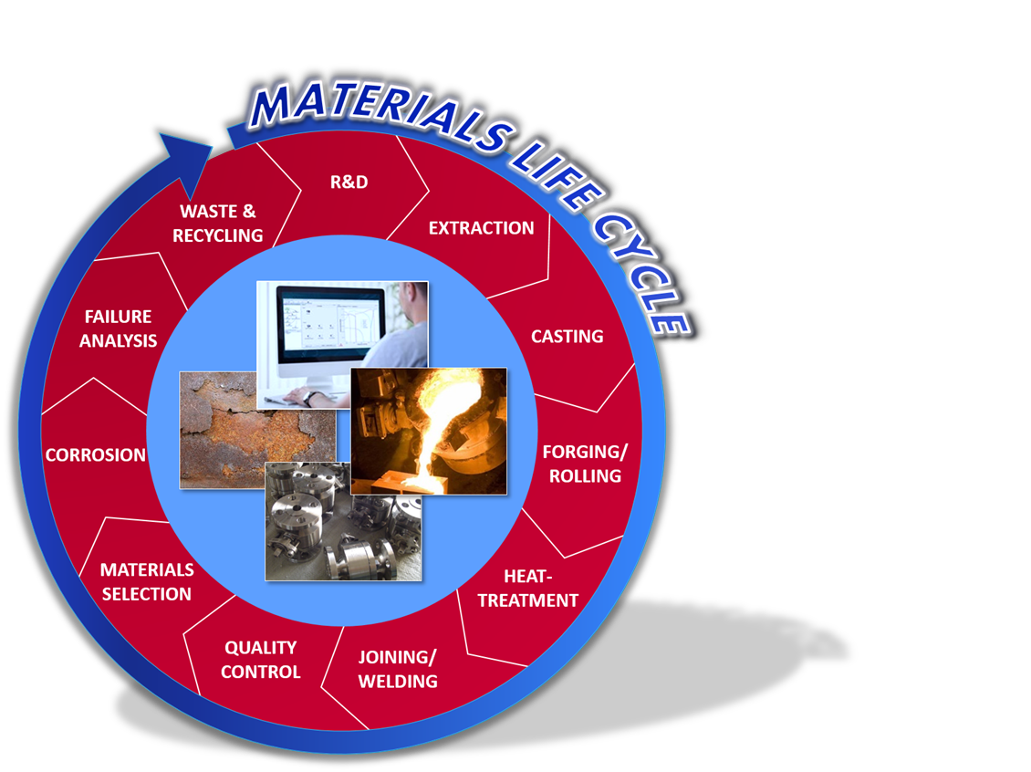
Examples with application to the materials life cycle

Slide 73

Example: Influence of alloy composition (1)
Example provided by Alojz Kajinic, Crucible Research (ATI Powder).
temperature = 2100°F
V + Nb = constant = 5.27 at. %
(wt. %)
X235 HTM
(Fe-C-20Cr-1Mo-V-Nb)

Slide 74

Example: Influence of alloy composition (2)
M₇C₃+MC
M₇C₃
temperature = 2100°F
V + Nb = constant = 5.27 at. %
MC
Fe-C-20Cr-1Mo-V-Nb

Slide 75

Example: Optimization of an alloy composition
Franck Tancret – Université de Nantes (TMS 2009):
Optimization of an alloy composition for the design of weldable and creep resistant superalloys using Matlab, TC-Matlab toolbox and neural net models. Over 16,000 compositions assessed.

Slide 76


Example: Forging and hot rolling
Selecting optimum temperature for operation.
Safe forging of supermartensitic stainless in γ-field
C 0,02%
Cr 12%
Ni 5%
Mo 2%
Mn, Si
Ti, N,
Fraction of phase
Temperature [C]
Courtesy André Costa e Silva

Slide 77

Example: Homogenizing a Ni based superalloy (1)
Homogenizing a Nickel based superalloy: Thermodynamic and kinetic simulation and experimental results.
Paul D Jablonski and Christopher J Cowen (NETL, Albany, OR)
Met. Trans. B. Vol 40B, April 2009 (pp 182-186)

Slide 78


Example: Homogenizing a Ni based superalloy (2)
Thermodynamic data from the Thermotech Ni-data database
Mobility data from the MOBNi1 database.
Scheil calculation
used to predict the fraction solid curve and incipient melting temp -1142°C.
and extent of chemical microsegregation - amounts of each alloying element in the FCC (g) phase
MC carbide forms
Carbides MC & M₆C lose stability

Slide 79

Example: Homogenizing a Ni based superalloy (3)

Slide 80


Example: Homogenizing a Ni based superalloy (4)
DICTRA simulations performed to simulate homogenization.
Assumptions: Diffusion distance of 50 mm based on approx one half of the maximum secondary dendrite arm spacing. Weight fraction of FCC scaled to this distance and read into DICTRA along with the chemistry profiles across the FCC dendrites from the Scheil simulations.
First heat treatment simulated at 1100°C (below incipient melting temp).
But incipient melting temp changes with chemical profile. In second case calculated a new incipient melting temp after 10,000 secs of 1275°C.
Significant improvement of the alloy homogeneity was predicted even after only 8.33 hrs (30,000 secs) @1200°C after the initial 10,000 secs @ 1100°C.

Slide 81

Example: Heat Treatment
Applications to a wide range of heat treatment related simulations, e.g. to calculate:
Gas phase reactions
Equilibrium between alloy and gas phase as a function
of temperature and composition
Predict formation of phases / volume-fractions etc.
Oxide scale formation
Decomposition of Acetylene at 10 mbar
Carbide dissolution
a_{C}>1.0

Slide 82

Example: Calculated Lehrer diagram
© 2011 Center for Heat Treating Excellence, Worcester Polytechnic Institute,
Worcester MA, all rights reserved

Slide 83
Example: Carburization of highly alloyed steels (1)
Use of activity-flux function in order to account for “surface reaction”.
J_{c} = f (a_{c}^{gas} – a_{c}^{surf})
where f is a mass-transfer coefficient that needs to be determined for each case.
The “surface-reaction” taking place at the steel surface (and the mass-transfer coefficient) is believed to be strongly affected by pressure.
AISI 1018 steel carburized at 899 ºC
f = 9.1 • 10⁻⁹ [m/s]
a_{c}^{gas} = 0.67
Mass-Percent C
4h
1h
30 min
Distance from surface [mm]

Slide 84
Example: Fe-13Cr-5Co-3Ni-2Mo-0.07C (I)
An example involving a complex alloy where alloying elements will tend to form carbides at high C-activities.
1750 ºF (955 ºC)
after 2.5h
J_{c} = 9.1 • 10⁻⁹ (0.9 – a_{c}^{surf})
M₇C₃
Mass-Percent of C
Fraction of carbide
cem
2.5h
M₂₃C₆
0.5h
Distance from surface [mm]
Distance from surface [mm]

Slide 85
Example: Fe-13Cr-5Co-3Ni-2Mo-0.07C (2)
Adding a 1.5h “diffusion step”.
2.5h
Mass-Percent of C
2.5h + 1.5h
Distance from surface [mm]

Slide 86
Example: Fe-13Cr-5Co-3Ni-2Mo-0.07C (3)
Cr depletion in the FCC matrix.
Mass-Percent of Cr
2.5h + 1.5h
2.5h
Distance from surface [mm]

Slide 87

Example: Fe-13Cr-5Co-3Ni-2Mo-0.07C (4)
Validation is important!
Complements experiments, does not replace the need to do them.
Turpin et al., Met. Trans. A 36 (2005), pp. 2751-60

Slide 88
Example: Precipitation kinetics M23C6 in AISI 316
Input data for simulation:
Composition
C 0,08%
Cr 18%
Ni 12%
Mo 2%
Mn 1.5%
Time & temperture
Nucleation at grainboundaries
@ 650 °C
γ-grainsize =100 μm
σ = 0.3 J/m²
@ 800 °C
γ-grainsize =1000 μm
σ = 0.2 J/m²
1000
[97Zah]
AISI 316
1073 K
923 K
100
Mean radius, nm
10
This work
1073 K
923 K
1
.01
.1
1
10
100
Time, hr

Slide 89

Example: Welding and joining
CALPHAD based tools such as Thermo-Calc and DICTRA with suitable databases can predict:
Liquid-gas equilibrium
Liquid-slag interactions
Formation of inclusions
Liquid-solid interactions
Weld metal solidification paths and temperature ranges
Microsegregation during solidification
Prediction of HAZ grain boundary liquation
Formation of precipitate phases at dissimilar welds
Post weld heat treatment and more….
S. Babu, International Materials Reviews, 2009 Vol. 54 No. 6

Slide 90


Example: Composition control
SAF 2507: Fe – 25% Cr – 7% Ni – 4% Mo – 0.27% N – 0.02% C. Sigma phase is predicted to be stable below 1030 ºC. How is this temperature influenced by changes in the alloy chemistry?
Variation analysis
Composition range:
Fe Base
Cr 23 – 27%
Ni 6 – 8%
Mo 3 – 5%
N 0.25 – 0.29%
C 0 – 0.03%
12⁵ = 248832 calculations

Slide 91


Example: Corrosion
These tools have also been applied to model different type of corrosion in alloys, e.g.
High-temperature oxidation
Salt corrosion
Aqueous corrosion
Pourbaix diagram for the heterogeneous interaction between 0.001 m of steel [Fe-5Cr-5Ni mole%] and 1 kg of water (and with 3 m NaCl), at 200oC and 100 bar.

Slide 92
Summary
An important part of ICME and the MGI is aimed at improving our ability to model how processes produce material structures, how those structures give rise to material properties, and how to select materials for a given application in order to design and make better materials cheaper and faster. This requires multiscale materials models to capture the process-structures-properties-performance of a material.
CALPHAD is a phase based approach to modeling the underlying thermodynamics and phase equilibria of a system through a self consistent framework that allows extrapolation to multicomponent systems. The approach has also been extended to consider multicomponent diffusion as well. CALPHAD provides an important foundation to ICME and the MGI in a framework that is scalable to multicomponent systems of interest to industry.
For more than 20 years CALPHAD based tools have been used to accelerate alloy design and improve processes with applications throughout the materials life cycle.

Slide 93
Questions?

