Slide 1
Nano: Scaling Laws
2.1
E 304
Dr. MC Ozturk, mco@ncsu.edu

Slide 2
Why is “the smaller, the better?”

Slide 3
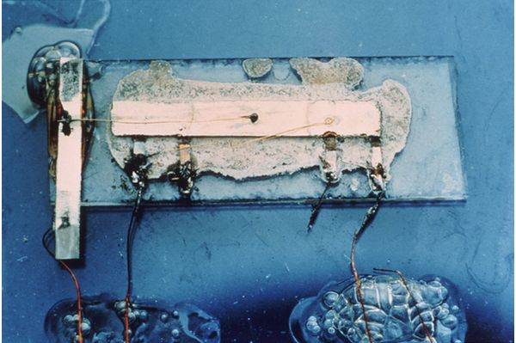
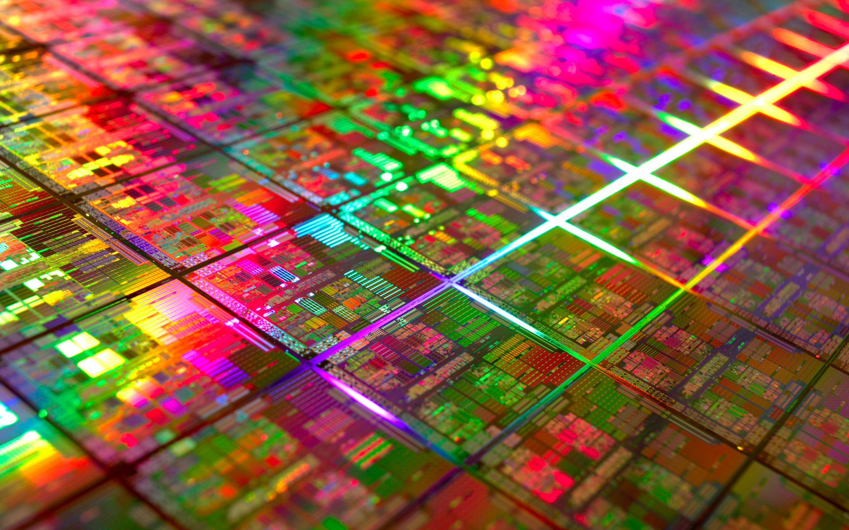
Scaling & Integrated Circuits
First Integrated Circuit
Texas Instruments
1958

Slide 4
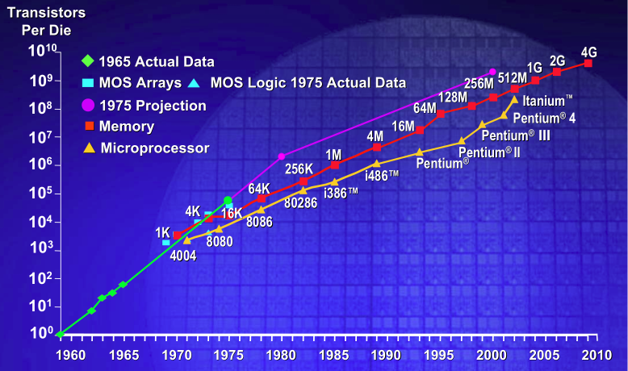
Moore’s Law
In 1965, Gordon Moore of Intel predicted that the number of transistors per chip would double every two years.

Slide 5
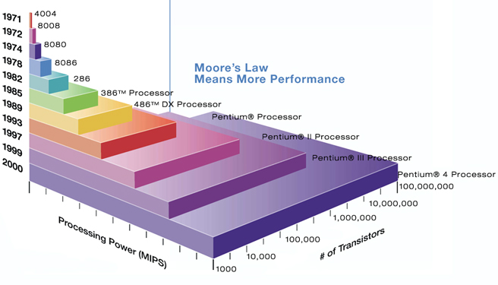
Scaling & Speed
MIPS: Million instructions per second

Slide 6
Scaling & Material consumption
Silicon consumed per transistor
Other materials – metals, insulators etc.
Chemicals & Gaseous precursors
Water

Slide 7
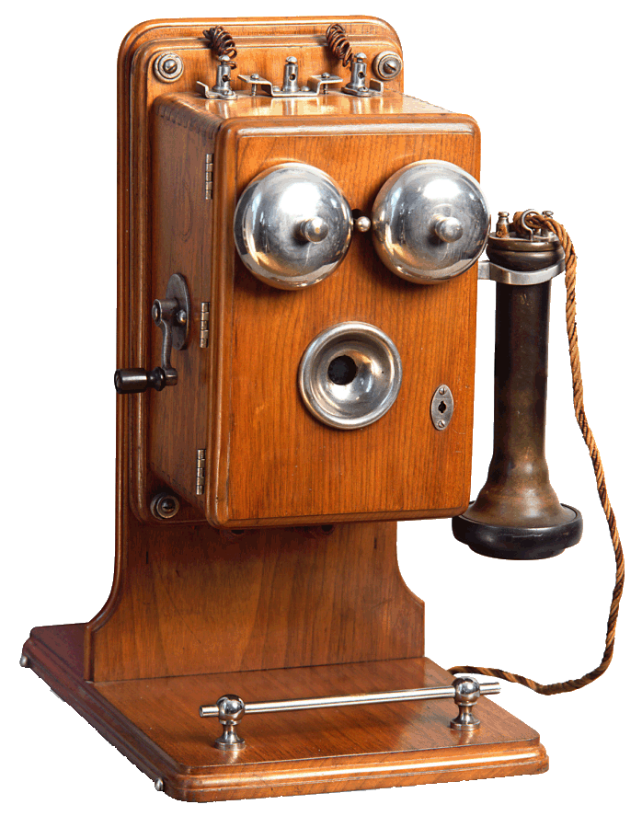
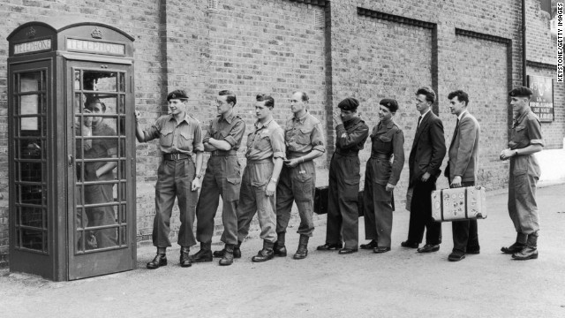
Scaling & Functional density
We can talk on the phone!

Slide 8
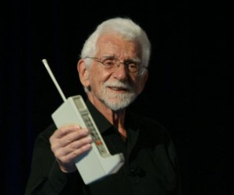
Scaling & Functional density
In 1973, Martin Cooper, the Division Manager of the Motorola Cellular Program, made the first call from a cell-phone on a busy street corner in New York, on the 6th Avenue by the New York Hilton. He called his competitor, Joe Engels at Bell Systems.

Slide 9
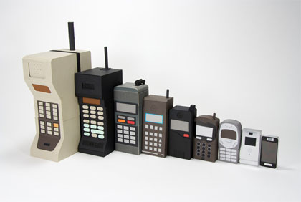
Scaling & Functional density
Functional density improves exponentially with scaling

Slide 10
Scaling & Vibrations
http://www.youtube.com/watch?v=LV_UuzEznHs
The resonant frequency of a system is inversely proportional to its mass

Slide 11
Scaling Laws

Slide 12
Characteristic Dimension “D”
  Most appropriate measurement unit

Slide 14
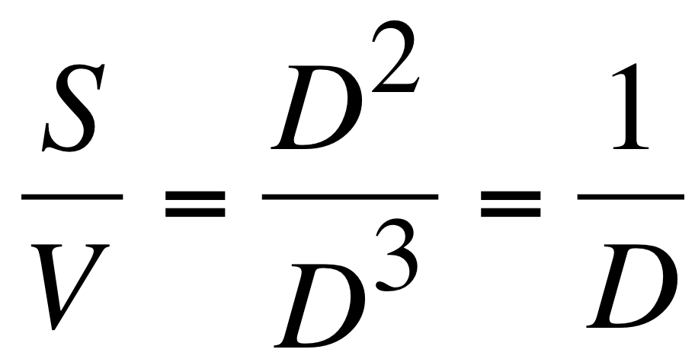
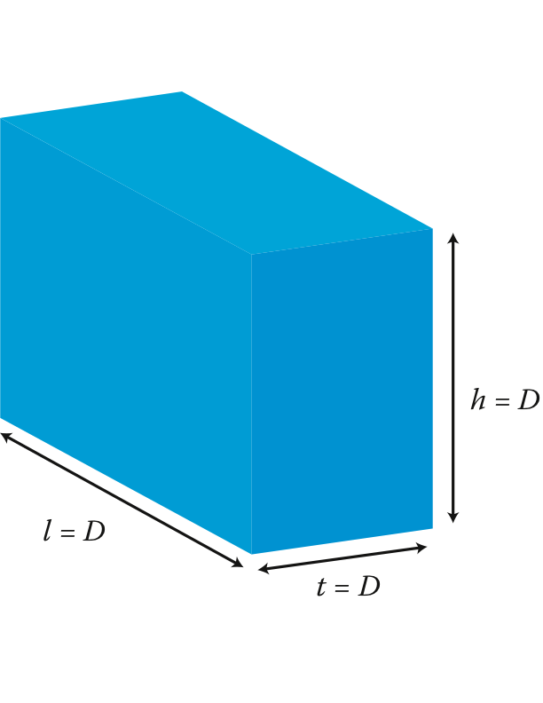
Surface to Volume Ratio

Slide 15
A Few Examples…

Slide 16
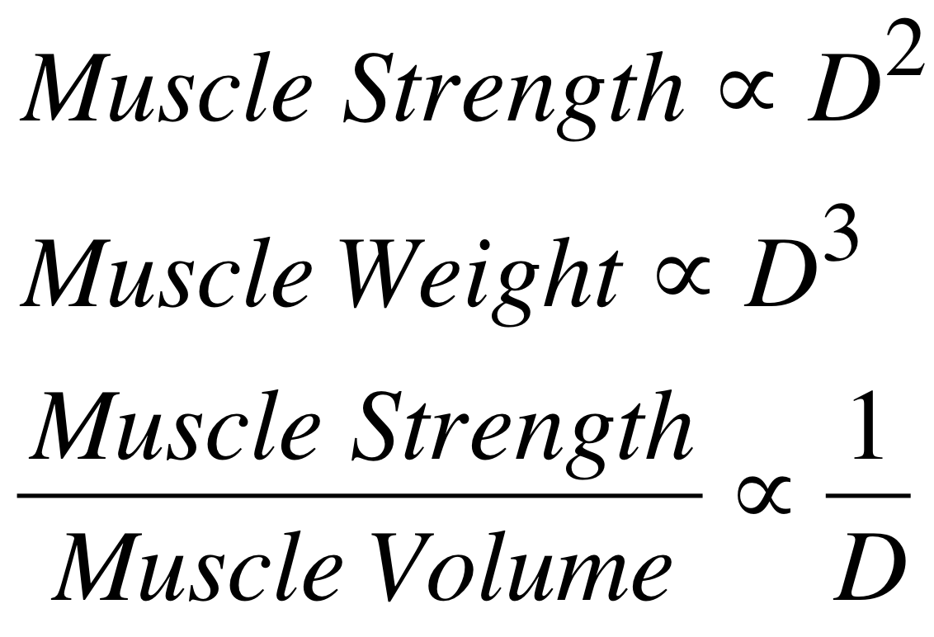
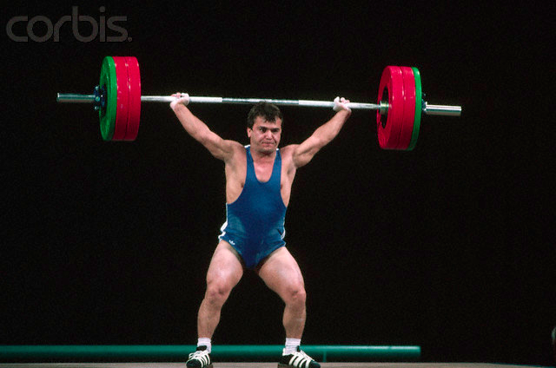
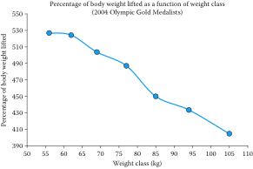
Scaling in Mechanics
Naim Suleymanoglu (4’11”)
3 Olympic championships
7 World championships
3 European championships

Slide 17
Scaling in Mechanics
At small dimensions, the contact area plays a much bigger role than the volume due to Van der Walls forces between atoms of the surface and the object.
Scaling laws do not always work well at atomic level!

Slide 18
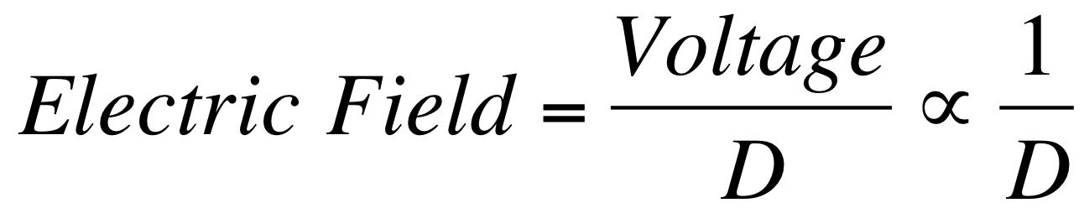
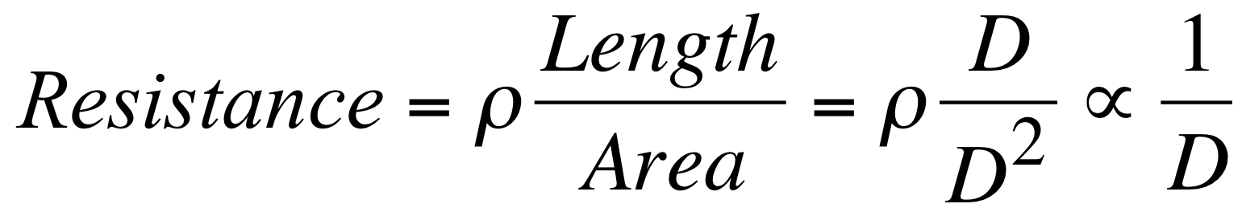
Scaling in Electricity
E
These simple equations have a significant impact on transistor scaling!
We will revisit this in Chapter 6

Slide 19
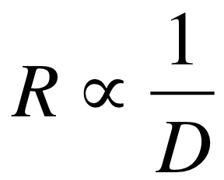
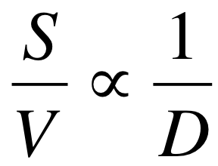
Application in Biosensing
Negatively charged electrons attracted under the oxide for charge neutrality
Positively charged virus
insulator
nanowire
Means the wire is highly resistive and attracting a few electrons can make a big difference in its resistance.
Means fewer viral particles we place on the surface will make a bigger difference in the wire resistivity
Detection of a single influenza virus has been demonstrated.

