Slide 1
Basic Portable Batch System (PBS)
Xufeng Wang, Kaspar Haume, Gerhard Klimeck
Network for Computational Nanotechnology (NCN)
Electrical and Computer Engineering
wang159@purdue.edu
khaume@purdue.edu
Last reviewed May 2013

Slide 2
The Portable Batch System (PBS)
One major computational resource available to NCN is the cluster system at Purdue.
The cluster system, with its abundant computational power, serves many users and carries massive amount of tasks, thus a workload management system is implemented upon it.
In order to use these resources, we as users must go through the management system called Portable Batch System (PBS) to properly schedule cluster usage.
PBS is the de facto standard on Linux clusters across the world.

Slide 3
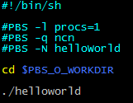
Demo #1: a PBS run example
We will use this example as a guide to learn about PBS piece by piece.
In the script file, all lines beginning with #PBS are understood by the PBS system as PBS commands – not as comments.
The have to be in the top, however. Otherwise they will be interpreted as comments by the shell.
The script does not have to have a specific file type ending, but to make it easier to sort out your files, I recommend the ending .pbs as in myjobfile.pbs

Slide 4
Composition of The PBS script
Shell header
PBS in-script options
PBS environment variables
Commands
In addition, PBS has its own Unix executable functions to submit the script, and monitor and modify the jobs. We will see them later.
Together, the in-script options, environment variables and the executable functions form the basis of PBS commands.

Slide 5
Shell Header
Shell header
PBS in-script options
PBS environment variables
Commands
By default PBS will run the script in your login shell, so if you are happy with that, you don’t need a shell header.
If you want to run the script in a different shell than your login shell, specify it with a shell header (as shown), or with the option –S
#PBS –S /bin/bash

Slide 6
Elements of PBS: PBS in-script options
PBS in-script options can be divided into two categories:
Resource allocation options
Run options
Resource allocation options can be further divided into:
Chunk allocation options
Job allocation options
Resource allocation
Chunk-wise
PBS in-script options
#PBS –l
#PBS –l nodes …
Run options
Job-wise
#PBS –q/N/…
#PBS –l walltime …

Slide 7
Resource allocation options
Before we hand the program to PBS, we need to explicitly request the resource.
Resources in PBS has two levels: chunk-wise and job-wise:
A chunk is basically a node on Purdue’s system
A job is basically the sum of all nodes
Resource node-wise (chunk-wise), we usually specify:
How many nodes we need
Cores on each node
Memory for each core
Resource job-wise, we usually specify:
Maximum runtime
Total memory for job
Notes:
Definition of chunk and job
Chunk wise resource allocation (-l select)
Job wise resource allocation (-l)
The “#PBS” prefix

Slide 8
Resource Allocation: Asking for multiple cores and nodes
N total cores on any number of nodes, distributed automatically by queuing system (job might start faster)
procs
Example
#PBS –l procs=N
N total cores distributed on exactly N nodes, one process per node
nodes
Example
#PBS –l nodes=N
N total cores distributed on exactly N nodes, one process per node, exclusive access to entire node
-n and nodes
Example
#PBS –n –l nodes=N

Slide 9
Resource Allocation: Asking for multiple cores and nodes
N total cores on same node
nodes and ppn
Example
#PBS –l nodes=1:ppn=N
To have exclusive access to entire node, set N = maximum number of cores per node on the given cluster
Example
#PBS –l nodes=1:ppn=24 (Rossmann)
(N*P) total cores on exactly N nodes with P processes per node
nodes and ppn
Example
#PBS –l nodes=N:ppn=P

Slide 10
Resource Allocation: Asking for memory
Size of memory per job
mem
Example
#PBS –l nodes=1:ppn=4
#PBS –l mem=10gb
Asking for 4 cores on 1 node, total memory = 10 GB
Size of memory per core/process
pmem
Example
#PBS –l nodes=1:ppn=4
#PBS –l pmem=2gb
Asking for 4 cores on 1 node, memory per process = 2GB. Total memory requested is then 8GB
Acceptable memory size units are: b, kb, mb, gb, tb

Slide 11
Resource Allocation: Asking for multiple cores and nodes
Remember that procs and ppn cannot be greater than the number of cores per node for the cluster.
For example, for Coates this is 8, for Rossmann this is 24.
The same goes for mem and pmem ; their sizes are limited by the cluster you are working on.
Refer to the user guides for each cluster for more information:
http://www.rcac.purdue.edu/userinfo/resources/

Slide 12
Run options: Requesting walltime
Maximum program run time
walltime
Example
#PBS –l walltime=8:00:00
Notice that this maximum time is a job-wise limit (that is, same on all nodes)
If program runs past this amount of time, it will be killed by PBS and return an error.
Walltime is specified in [hours]:[minutes]:[seconds] form.

Slide 13
Run options: Queue
PBS queue
-q
Example
#PBS –q ncn
Queue is the realm of privilege where a user can submit his/her job to. As NCN member, you are eligible to submit jobs to NCN owned queue and a common queue called “standby”
If not specified, all jobs will be sent to standby queue.
About “standby” queue
The “standby” queue is composed of all unused resources on the cluster and every user is able to access it.
It has a 4 hours max walltime.

Slide 14
Run options: Output and Error files
PBS output/error file location and names of files
-o / -e
Example
#PBS –o /wang159/mydir –e /wang159/mydir
#PBS –o output.txt –e error.txt
PBS by default dumps the output and error messages into two separate files in the working directory.
With this option, you are able to choose where you would like to place those files and the names of the files
Put output and error messages together in one file. oe → to output file, eo → to error file
-j
Example
#PBS –j oe

Slide 15
Run options: Job Name
PBS job name
-N
Example
#PBS –N nanowire_a1
This option allows you to choose a specific name for your job.
It is useful in case you have multiple jobs running.

Slide 16
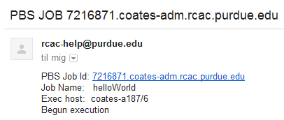
Run options: Email Notifications
Have PBS email you with information
-a : job aborted
-b : job begun
-e : job terminated
-M
-m abe
Example
#PBS –M username@gmail.com
#PBS –m abe
This allows you to receive information about you job
Example from Gmail

Slide 17
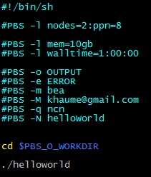
Demo #1
Example script with options covered so far
Chunk-wise
Resource allocation
Job-wise
Run options

Slide 18
Elements of PBS script: PBS environment variables
Shell header
PBS in-script options
PBS environment variables
Commands

Slide 19
Elements of PBS script: PBS environment variables
PBS environment
The PBS environment variables serves the same purpose as the ones commonly used in Unix; they contains information about the run-time environment of PBS such as working directory, user id, job id and others.
There are two kinds of PBS environment variables:
Ones inherited from the shell you submitted your PBS script from. (It has the form of PBS_O_)
Ones that are not inherited. (Do not contain “O”)

Slide 20
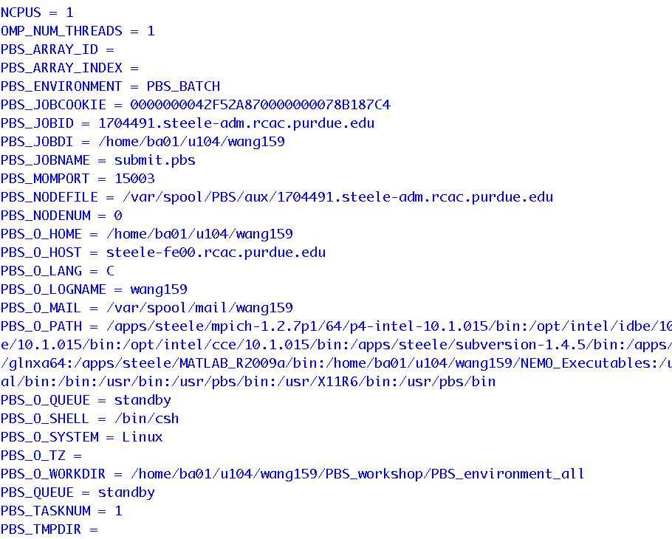
List of PBS environment variables

Slide 21
Common environment variables
If running under PBS
PBS_ENVIRONMENT
Boolean variable. Useful for telling if the script is currently running under PBS
PBS job ID / job name
PBS_JOBID / JOBNAME
This returns a value that is unique to a certain job. Useful for discriminating different jobs that are running altogether.
Executable PATH (inherited)
PBS_O_PATH
If program is not within the paths defined here, it won’t be found by the program.

Slide 22
Common environment variables
Current working directory (inherited)
PBS_O_WORKDIR
You will end up at your home folder after connecting to the cluster.
If you want to run files in the directory where the qsub command was executed, you have to cd to that folder.
$PBS_O_WORKDIR contains the full address of where the script was executed, and is thus an easy way to get back to that folder.

Slide 23
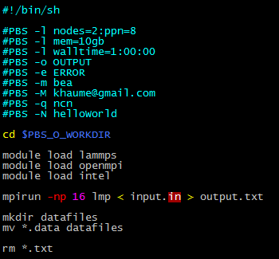
Demo #2
Shell header
PBS in-script options
PBS environment variables
Commands

Slide 24
Executable Functions
Remember that the basis of PBS commands consists of the in-script options, environment variables and the executable functions form the basis of PBS commands.
Let’s take a look at the executable functions used to submit the script, and monitor and modify the jobs.

Slide 25
Submitting a PBS script
Submission of a job
qsub
qsub [script] will simply submit the job request to PBS. A successful submission will show a job ID.

Slide 26
Checking job status
Checking job status
qstat -a
NDS | Number of nodes used
TSK | Total number of processes
Req’d Memory | Total RAM requested
Req’d Time | Walltime
Elap Time | Has run for how long
S | Meaning
Q | queued
R | running
H | hold
E | exiting

Slide 27
Checking job status
Checking job status
qstat –u
qstat and qstat –a will give you a quick view of all current running jobs on the server on all queues.
Too see your own, use –u yourusername

Slide 28
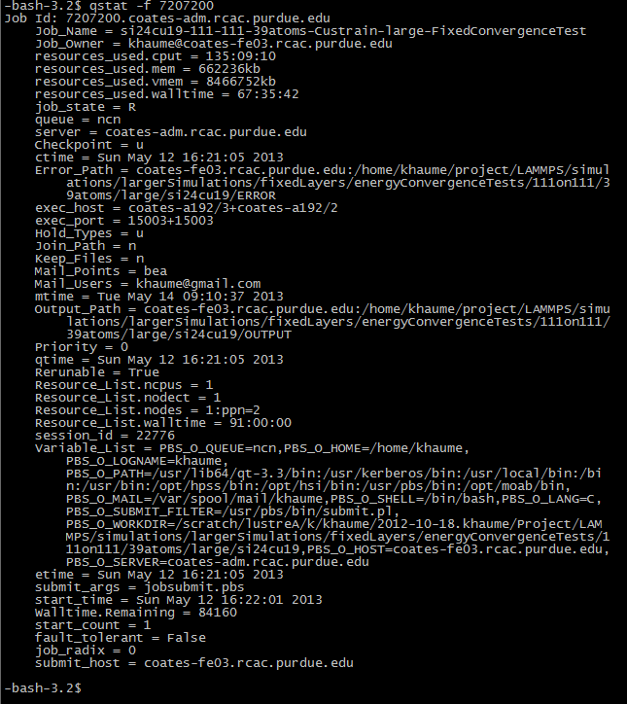
Checking job status
Checking job status
qstat –f
qstat –f [jobID] will give you full information about the job, with nodes are used, output paths, memory used etc.
Alternatively, the command checkjob –v [jobID] does almost the same

Slide 29
Checking queue status
Checking queue status
qstat –Q
qstat –Q will give an overview of the queue
Refer to man qstat → “Displaying Queue Status”

Slide 30
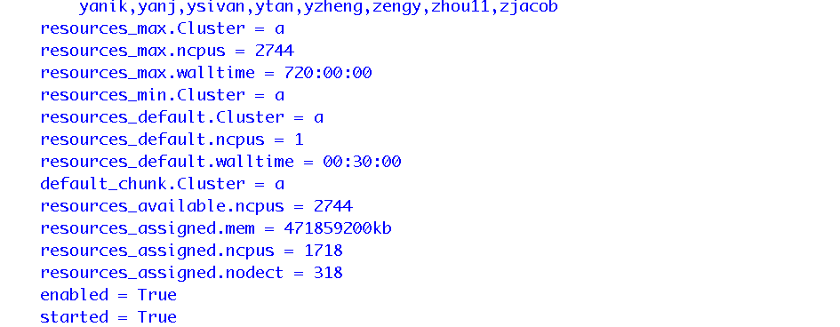
NCN queue
qstat –Qf ncn

Slide 31
Delete your jobs
Delete specific job(s)
qdel
Example
Correctly delete a job of yours
Attempting to delete a job of others
You may only delete a job of yours, not others.

Slide 32
Selecting specific jobs
Selecting specific job(s)
qselect
Selecting your jobs
Can be used to delete all jobs returned by qselect
Or you can write out a list of all your jobs to a file

Slide 33
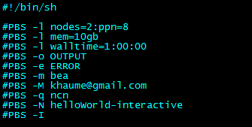
Interactive jobs
If you want direct control of your job, there is one more way to run jobs on the cluster. This is called “interactive jobs”.
If you supply the option –I (capital “i” ), you will be interactively connected to your requested nodes, which means that you can navigate your folders and files as normally.
The job will be waiting in the queue until ready. Then just run the commands as you otherwise would have done. When done, type exit, otherwise you will be disconnected after your walltime is up.
If the job is interactive, all commands past the last #PBS line are ignored
Notes:
Definition of chunk and job
Chunk wise resource allocation (-l select)
Job wise resource allocation (-l)
The “#PBS” prefix

Slide 34
PBS scripts together with command line arguments
This guide was about writing PBS scripts to take care of everything to make the process of submitting jobs fast and easy. But that’s not the only way…
You can also combine PBS script arguments with command line arguments. All arguments we have seen in this guide can be provided as a command line argument.
To see all possible commands, refer to the qsub manual: bash$ man qsub
In case of a conflict between command line arguments and arguments in the script, the command line takes precedence.
Notes:
Definition of chunk and job
Chunk wise resource allocation (-l select)
Job wise resource allocation (-l)
The “#PBS” prefix

Slide 35
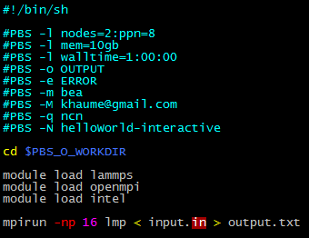
Example: Script and Command Line comparison
As mentioned , all #PBS lines in scripts can be written out on the command line as arguments to qsub.
A purely command line call to qsub is only useful if an interactive job is wanted because everything after the last #PBS is ignored.
This example shows how the PBS script compares to the command line.
Notes:
Definition of chunk and job
Chunk wise resource allocation (-l select)
Job wise resource allocation (-l)
The “#PBS” prefix

Slide 36
Topics in next presentation “Advanced PBS”
Modifying queued job attributes
Job arrays
Hold/reshuffle jobs orders
Sending message/signals to jobs
Moving jobs between queues
Passing variables to jobs
Job dependencies

