Slide 1
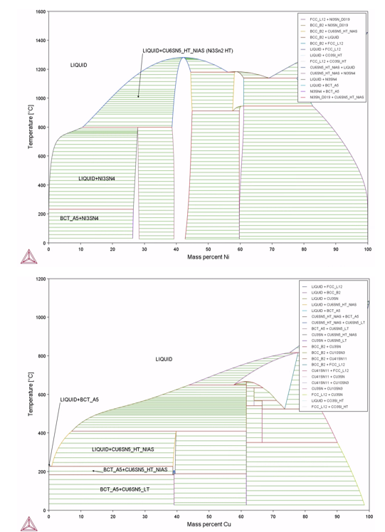
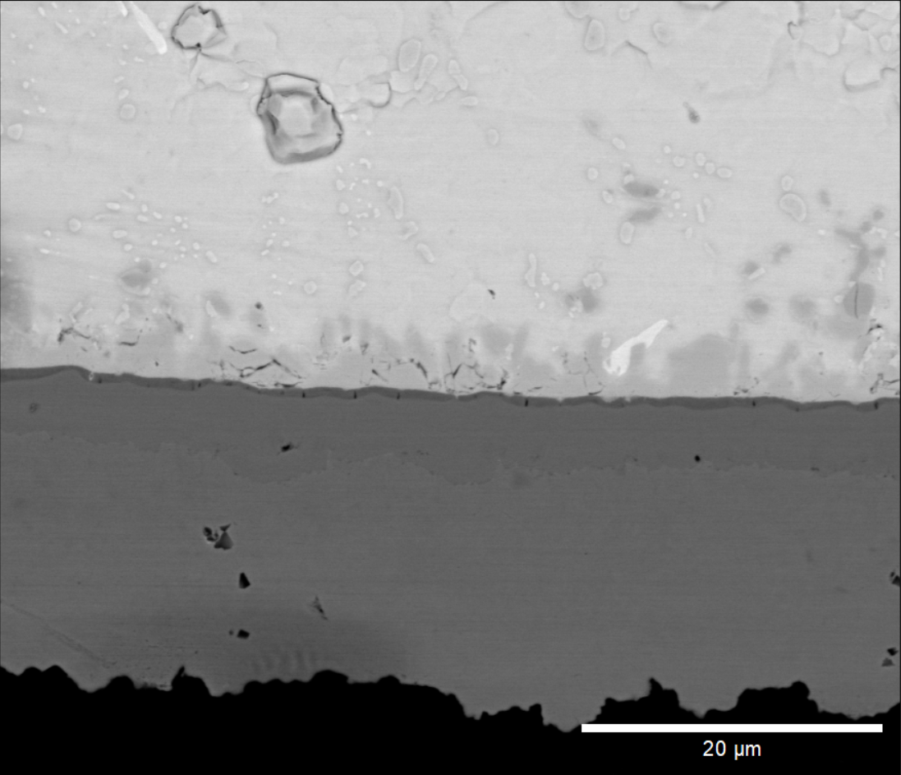
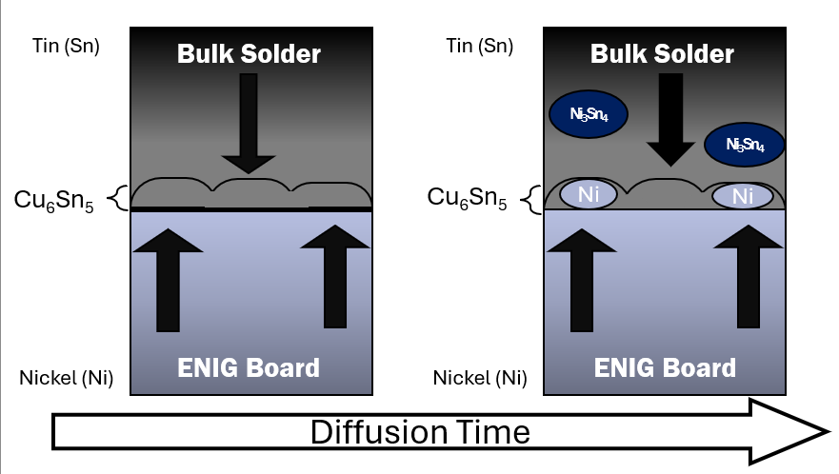
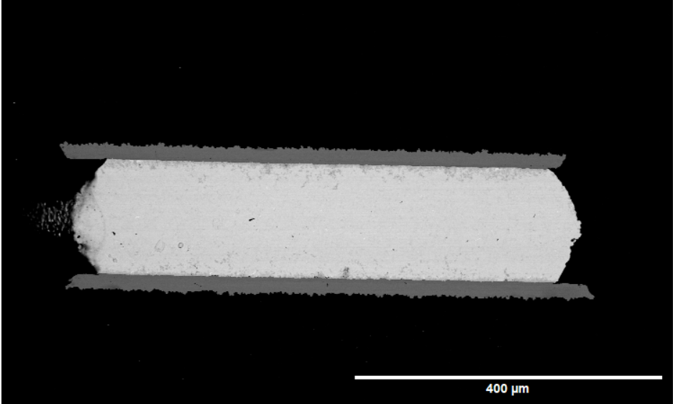
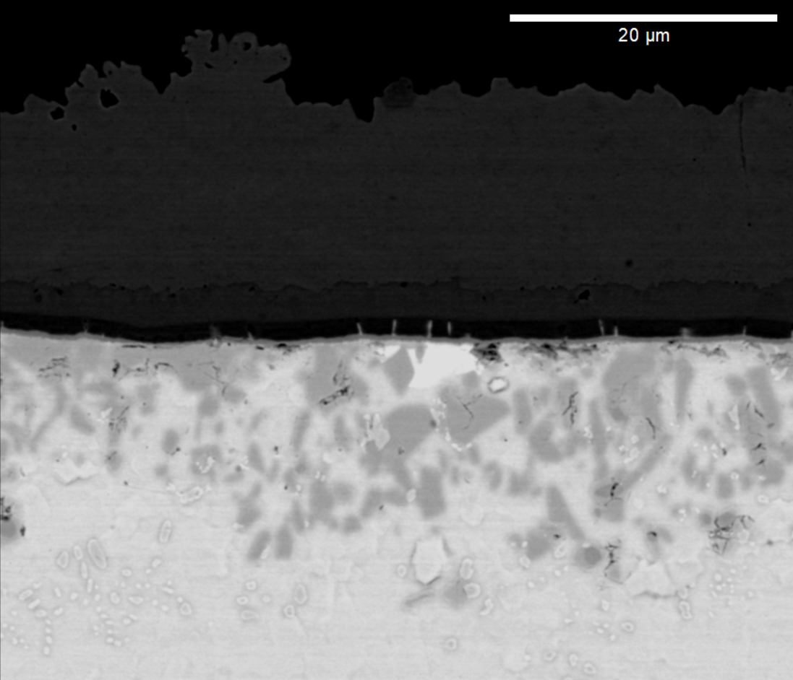
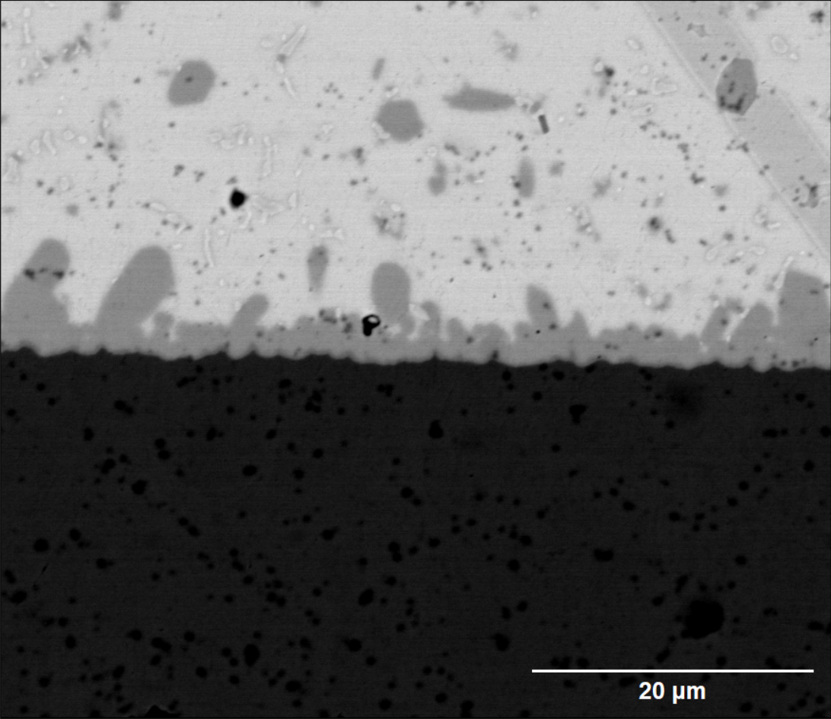
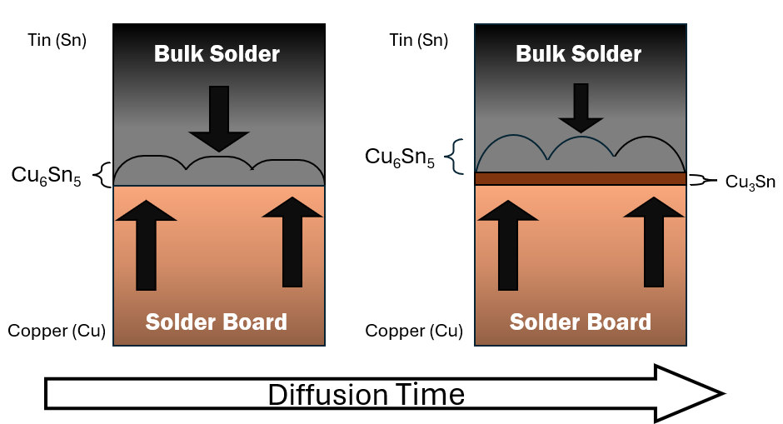
Investigating aging effects on the Cu, Ni and Au intermetallic in high temperature solders Nathaniel Weddington- nwedding@purdue.edu
SCALE Heterogenous Integration /Advanced Packaging
Alpha MacDermid provided the solder balls that were used for this ongoing project. The contributors to this poster include Lijia Xie, Yifan Wu, Hevi Kenula Medde-Witage, Professor Handwerker and Professor Blendell.
OVERVIEW
The process in which solder samples are created involves melting and resolidification. The composition of these solder balls consists of tin, silver and nickel. Once we receive these samples, they are remelted the sample onto a solder board and solidified. Solid - solid diffusion occurs in the aging process. The diffusion of metals creates an intermetallic layer in the solder joint with various compositions such as (Cu₆Sn₅, Ni₃Sn₄, and AuSn₂) depending on the solder board surface finish. The purpose of looking into this diffusion process is to understand the solubility depth into the specimen and the formation and growth of intermetallic layer.
Phase Diagrams
Microstructure Findings and Analysis of IMCs
The solid-state diffusion occurs as copper and tin migrate between each phase due to the specimen being heated. Copper moves easier into the tin phase as the tin is closer to a liquid state due to a lower melting point. For the OSP boards after a certain amount of time of diffusion, there's growth in the Cu₆Sn₅ intermetallic layer. However, there's a point at which the copper cannot flow into the bulk solder causing it to stack up along the bottom of the IMC layer which creates Cu₃Sn. The copper moving into the solder ball causes more build up of Cu₆Sn₅ which now creates a barrier for more copper to diffuse into the solder. The traveling distance of the nickel is limited potentially due to time. This intermetallic formation is an interesting finding as the nickel comes from the solder board and diffuses relatively far into the solder. The phenomenon occurs as the nickel has a limited amount of solubility in Cu₆Sn₅. The nickel particles move effortlessly into the tin phase as the tin is closer to reaching its liquid state due to its lower melting temperature. In addition to that the nickel in this intermetallic layer does not increase the thickness of the layer but creates darker particles since the composition becomes heavier.
Intermetallic annotations:
1: Tin (Sn)
2: Gold Tin-2 (AuSn₂)
3: Nickel-3 Tin- 4 (Ni₃Sn₄)
4: Copper-6 Tin-5 (Cu₆Sn₅)
5: Copper-3 Tin; (Cu₃Sn)
Image 1 : Schematic of specimen
Experimental Overview
Image 4: Solid-solid diffusion coupling situations
Image 2 (SEM - BSE):
Innolot ENIG aged at 125C 90D
This project focuses on the intermetallic layer's formation and changes within the microstructure of solder samples. The solder ball is placed onto the board and passed through a reflow oven at 265°C. The sample's aging occurs as samples are placed in oven at a specific temperature and length of time. Once the aging process is completed the sample would be mounted in epoxy and polished to examine its microstructure by utilizing a scanning electron microscope (SEM) and an energy dispersive X-ray spectroscopy (EDX/EDS).
1
2
2
Conclusion and future work
1
Basic understanding of the diffusion process due to the aging
Analysis of the intermetallic compositions using different tools and phase diagrams.
Understanding how the Innolot bulk solder develops overtime as the specimen aged.
The next step our research team is looking into why Ni₃Sn₄ goes so far into the bulk solder. Another aspect of this diffusion process that is of interest is understanding whether gravity plays a role in this diffusion process.
1
Image 3 (SEM-BSE):
Innolot OSP aged at 75C 7D
2
1
4
5
3
4
3

